Slide 2
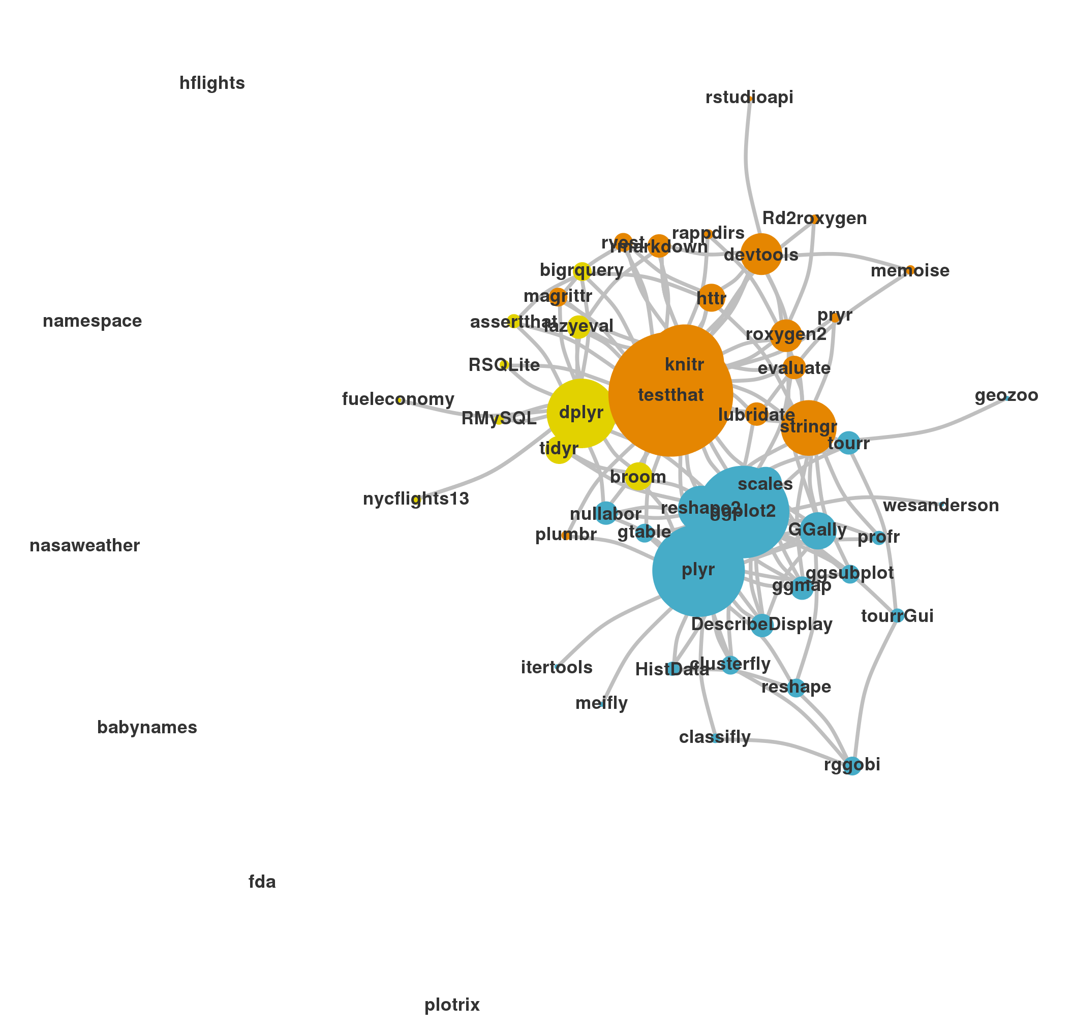
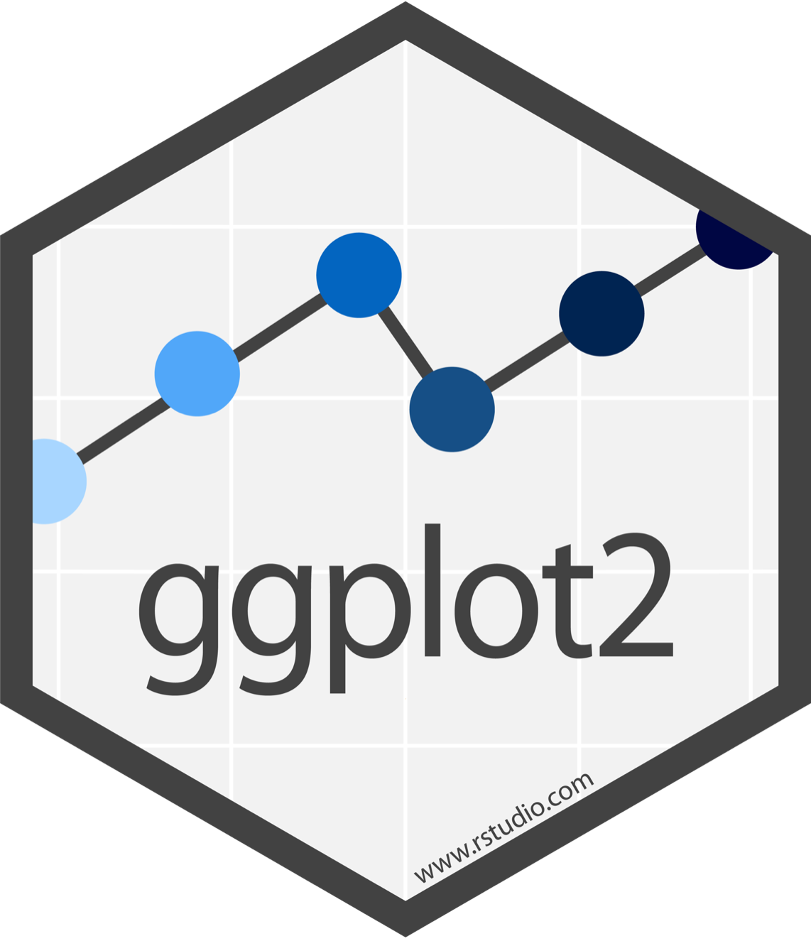
Display by Adolfo A ́lvarez
CC BY-SA RStudio

Slide 3
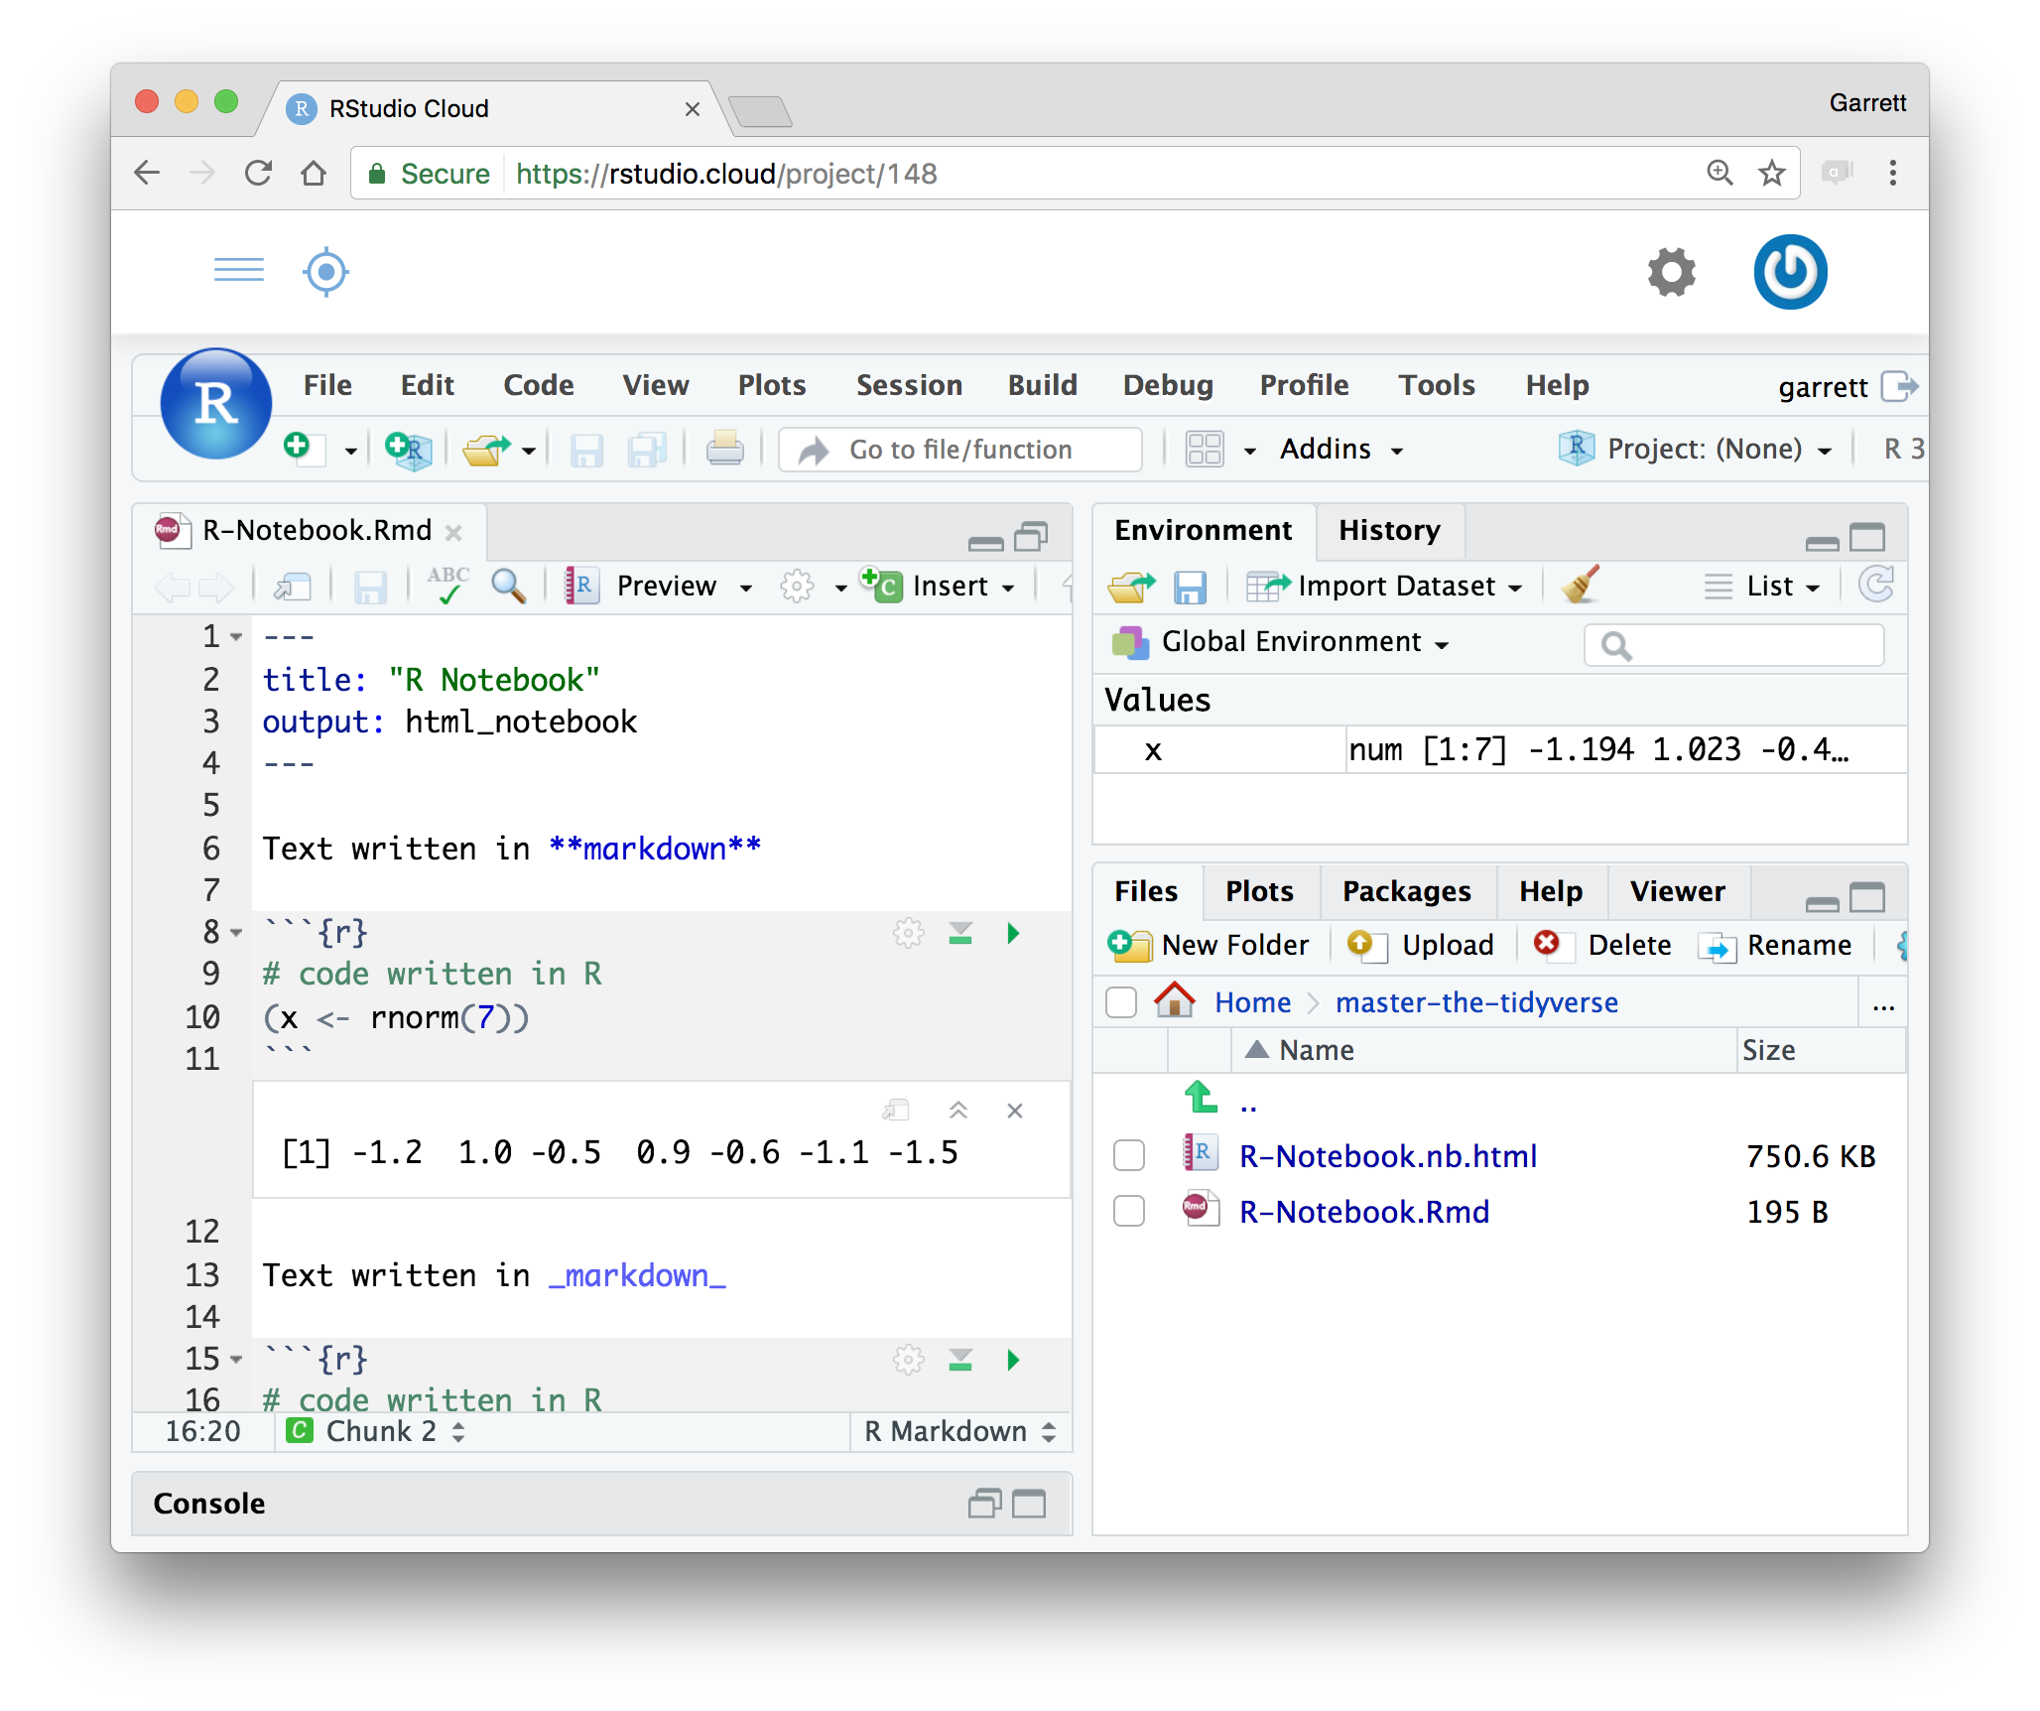
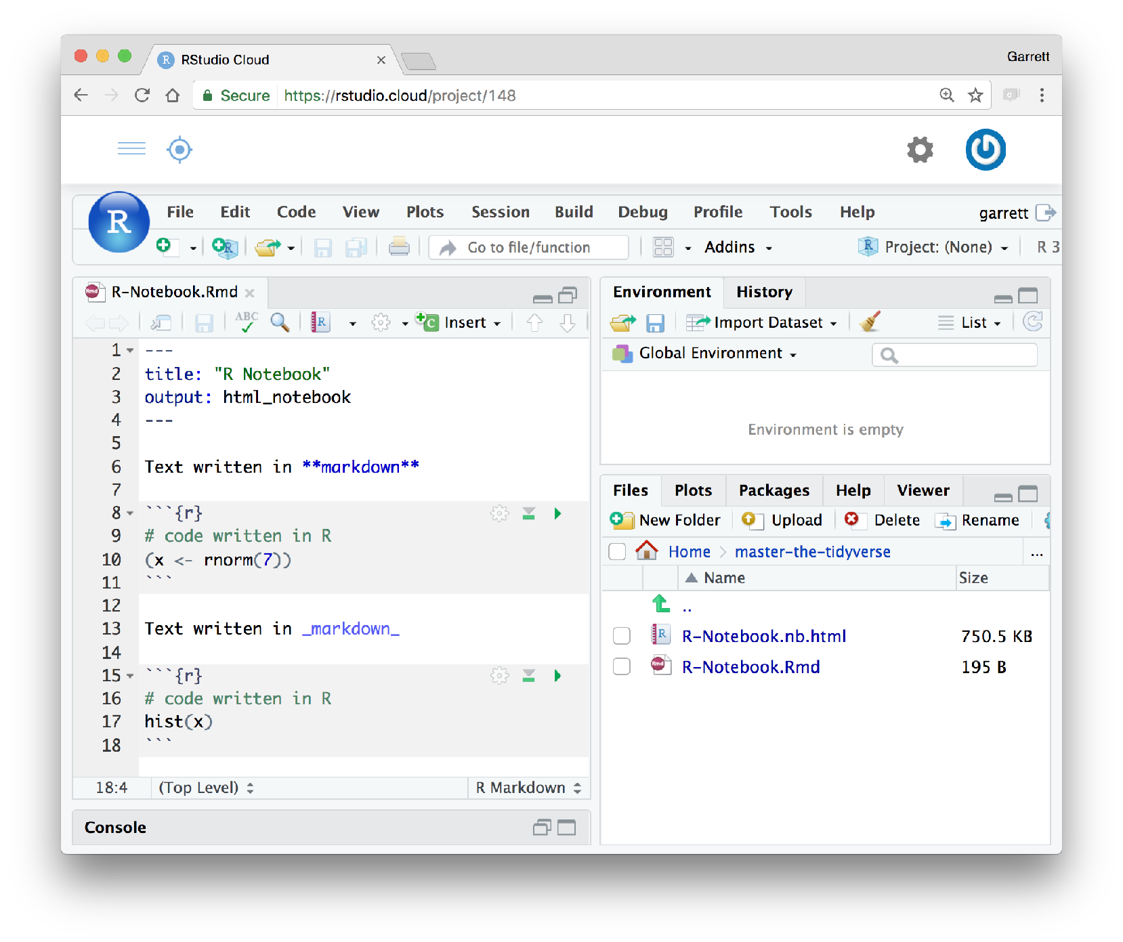
R Notebooks - reminder
Click to run all code chunks above
Click to run code in chunk
Code result
CC BY-SA RStudio

Slide 4
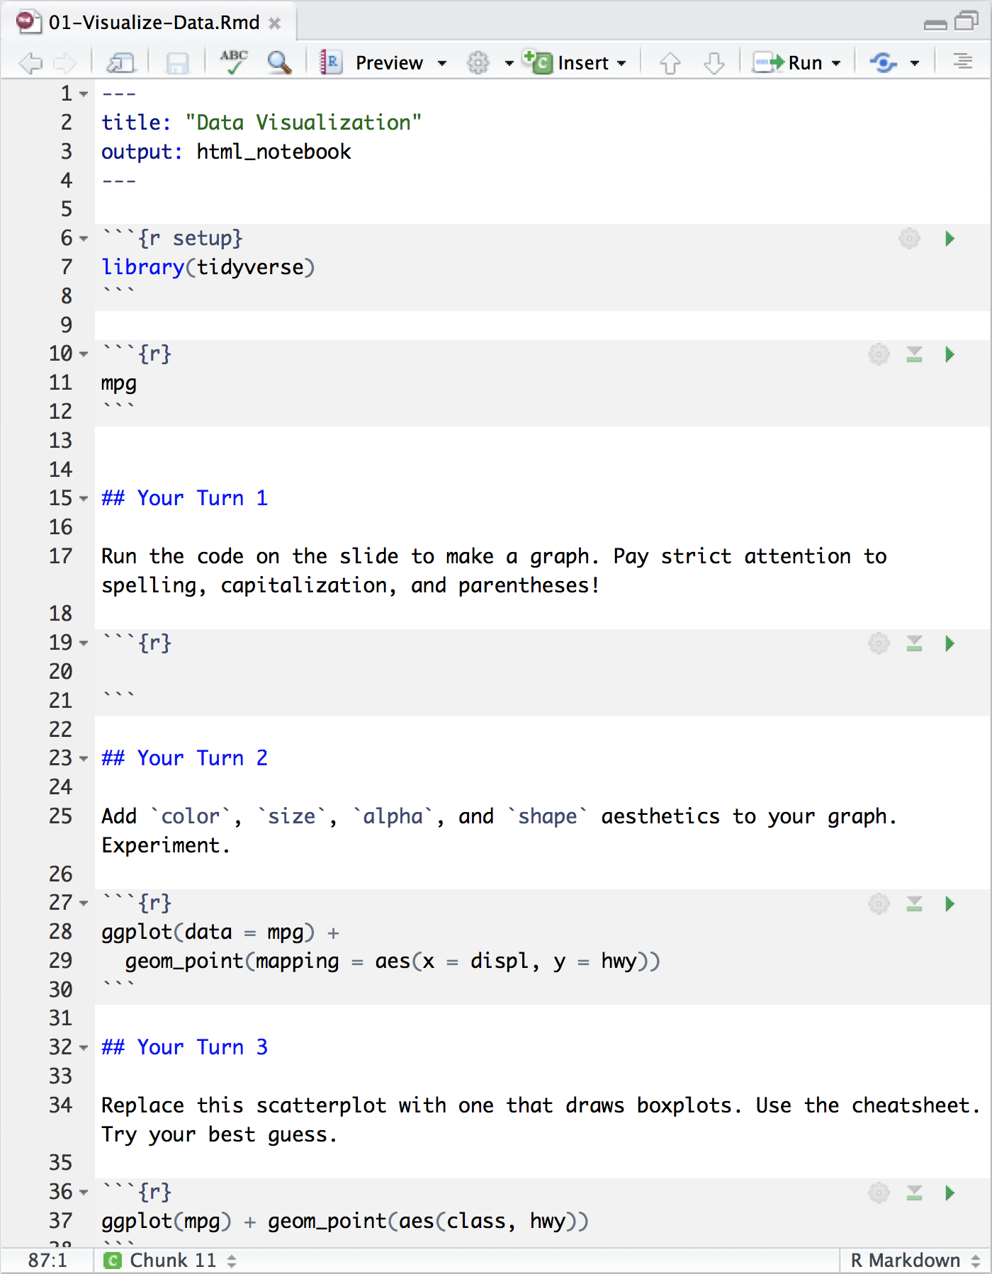
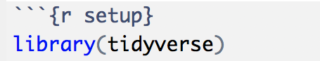
Setup
The setup chunk is always run once before anything else
chunk labels are optional,
the setup label is special
CC BY-SA RStudio

Slide 5
mpg
Fuel economy data for 38 models of car.
mpg
CC BY-SA RStudio

Slide 6
Quiz
What relationship do you expect to see between engine size (displ) and mileage (hwy)?
No peeking ahead!
1 minute

Slide 7
Your Turn 1
Open /exercises/01_Visualize-Data.Rmd.
Add the code below to the grey code chunk under the section titled "## Your Turn 1" and run the chunk (using the green arrow) to test your code.
Pay strict attention to spelling, capitalization, and parentheses!
ggplot(data = mpg) +
geom_point(mapping = aes(x = displ, y = hwy))
2 minutes

Slide 8
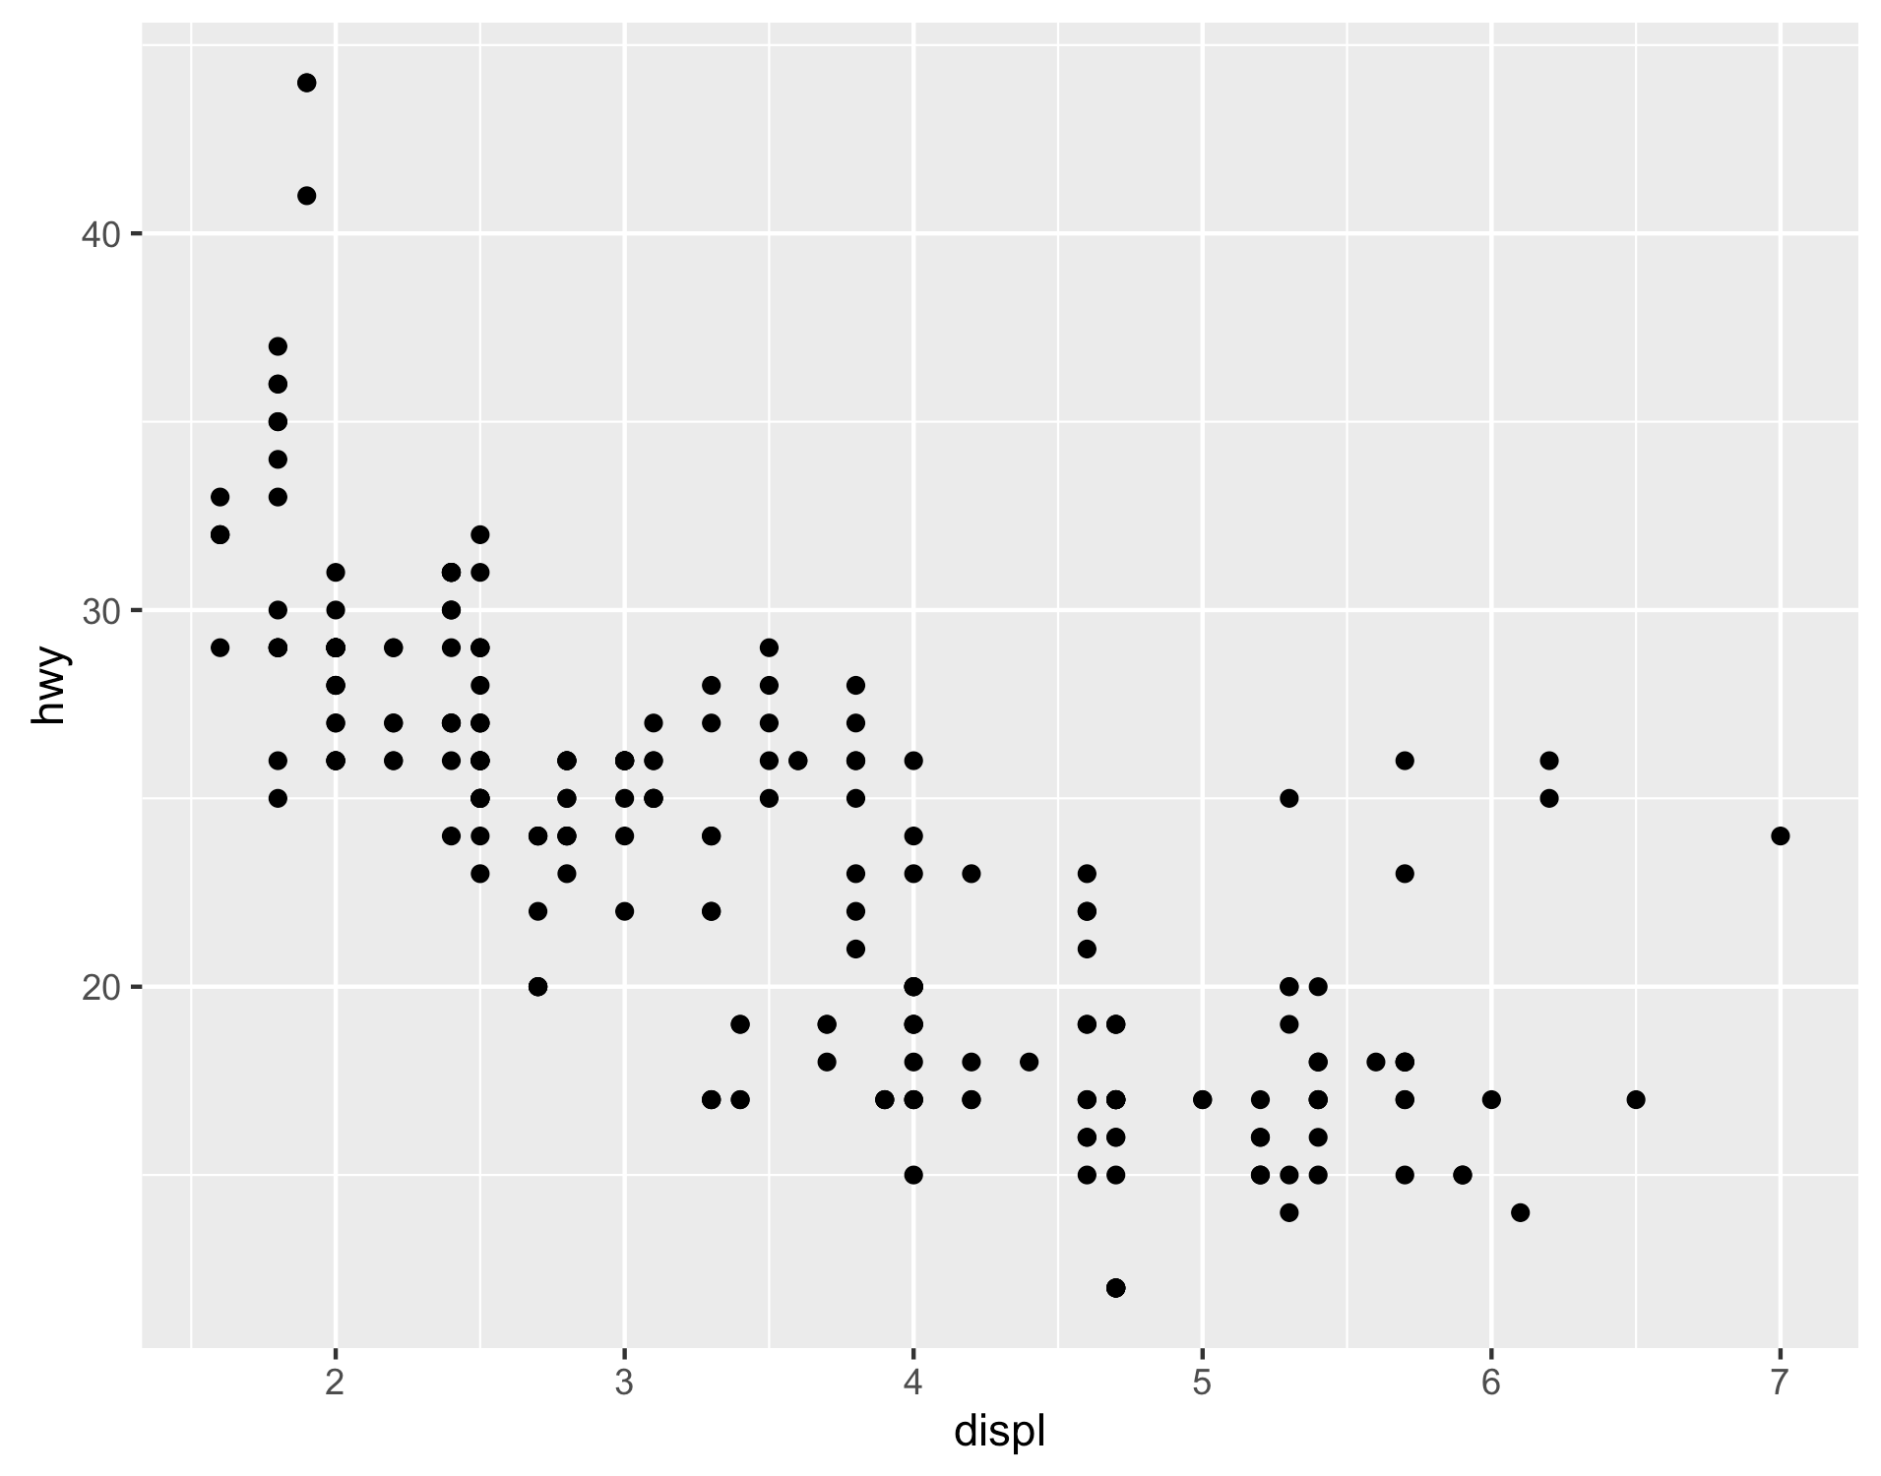
ggplot(data = mpg) +
geom_point(mapping = aes(x = displ, y = hwy))
CC BY-SA RStudio

Slide 9
"Initialize" a plot with ggplot()
Add layers with geom_ functions
ggplot(data = mpg) +
geom_point(mapping = aes(x = displ, y = hwy))
CC BY-SA RStudio

Slide 10
Always put the + at the end of a line, Never at the start
ggplot(data = mpg) +
geom_point(mapping = aes(x = displ, y = hwy))
CC BY-SA RStudio

Slide 11
data
+ before new line
ggplot(data = mpg) +
geom_point(mapping = aes(x = displ, y = hwy))
type of layer
aes( )
x
y variable
CC BY-SA RStudio

Slide 12
A template
ggplot(data = <DATA>) +
<GEOM_FUNCTION>(mapping = aes(<MAPPINGS>))
ggplot(data = mpg) +
geom_point(mapping = aes(x = displ, y = hwy))
CC BY-SA RStudio

Slide 13
A template
ggplot(data = <DATA>) +
<GEOM_FUNCTION>(mapping = aes(<MAPPINGS>))
CC BY-SA RStudio

Slide 14

Mappings

Slide 15
How can we test the theory?
Why do these cars get better mileage?
ggplot(data = mpg) +
geom_point(mapping = aes(x = displ, y = hwy))
CC BY-SA RStudio

Slide 16
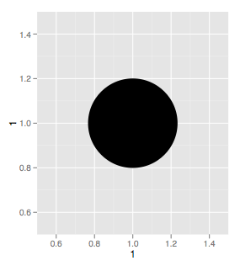
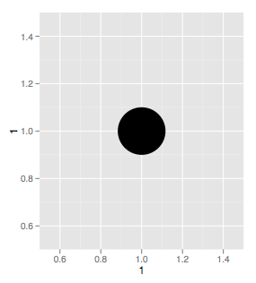
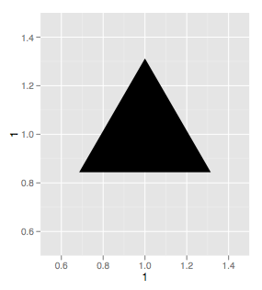
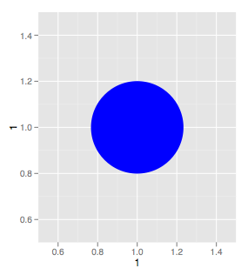
Aesthetics
CC BY-SA RStudio

Slide 17
Visual Space
Data Space
color
class
Red
Brown
Green
Aqua
Blue
Violet
Pink
2seater
compact
midsize
minivan
pickup
subcompact
suv
CC BY-SA RStudio

Slide 18
Aesthetics
aesthetic property
Variable to map it to
ggplot(mpg) + geom_point(aes(x = displ, y = hwy, color = class))
ggplot(mpg) + geom_point(aes(x = displ, y = hwy, size = class))
ggplot(mpg) + geom_point(aes(x = displ, y = hwy, shape = class))
ggplot(mpg) + geom_point(aes(x = displ, y = hwy, alpha = class))
CC BY-SA RStudio

Slide 19
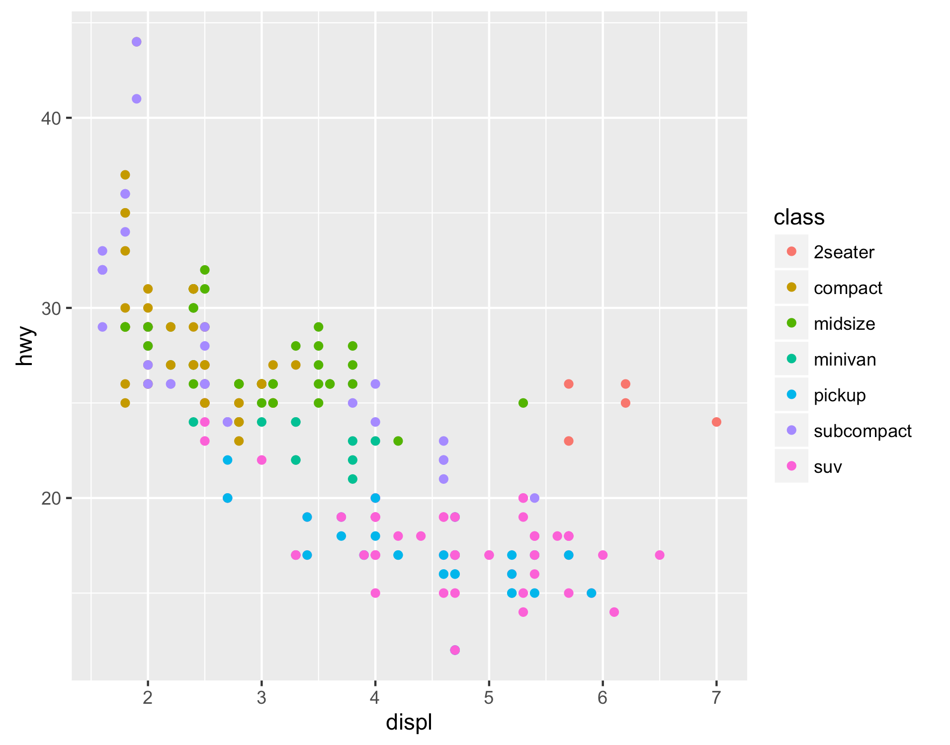
Legend added automatically
ggplot(data = mpg) +
geom_point(mapping = aes(x = displ, y = hwy, color = class))
CC BY-SA RStudio

Slide 20
MKS Top tip
ggplot(data = <DATA>) +
<GEOM_FUNCTION>(mapping = aes(<MAPPINGS>))
I find that it helps to explicitly name the `mapping` argument.
It helps me remember that it is mapping aesthetics on the plot (colour, size, shape, etc.) to data variables.
CC BY-SA RStudio

Slide 21
Your Turn 2
In the next chunk, add color, size, alpha, and shape aesthetics to your graph. Experiment.
Do different things happen when you map aesthetics to discrete and continuous variables?
What happens when you use more than one aesthetic?
5 minutes

Slide 22
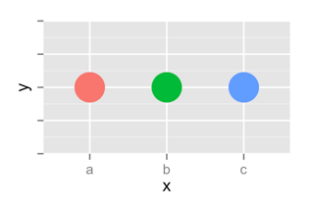
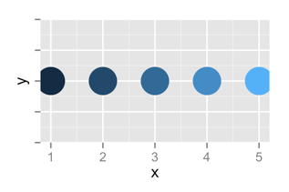
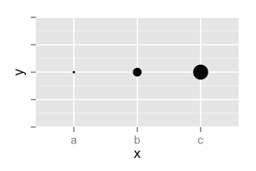
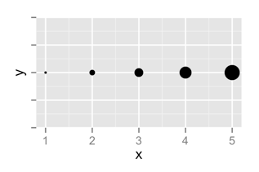
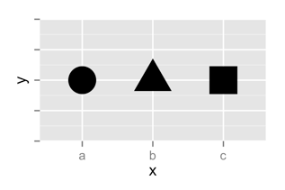
 | Discrete | Continuous
Color
Size
Shape
CC BY-SA RStudio

Slide 23
set vs. map

Slide 24
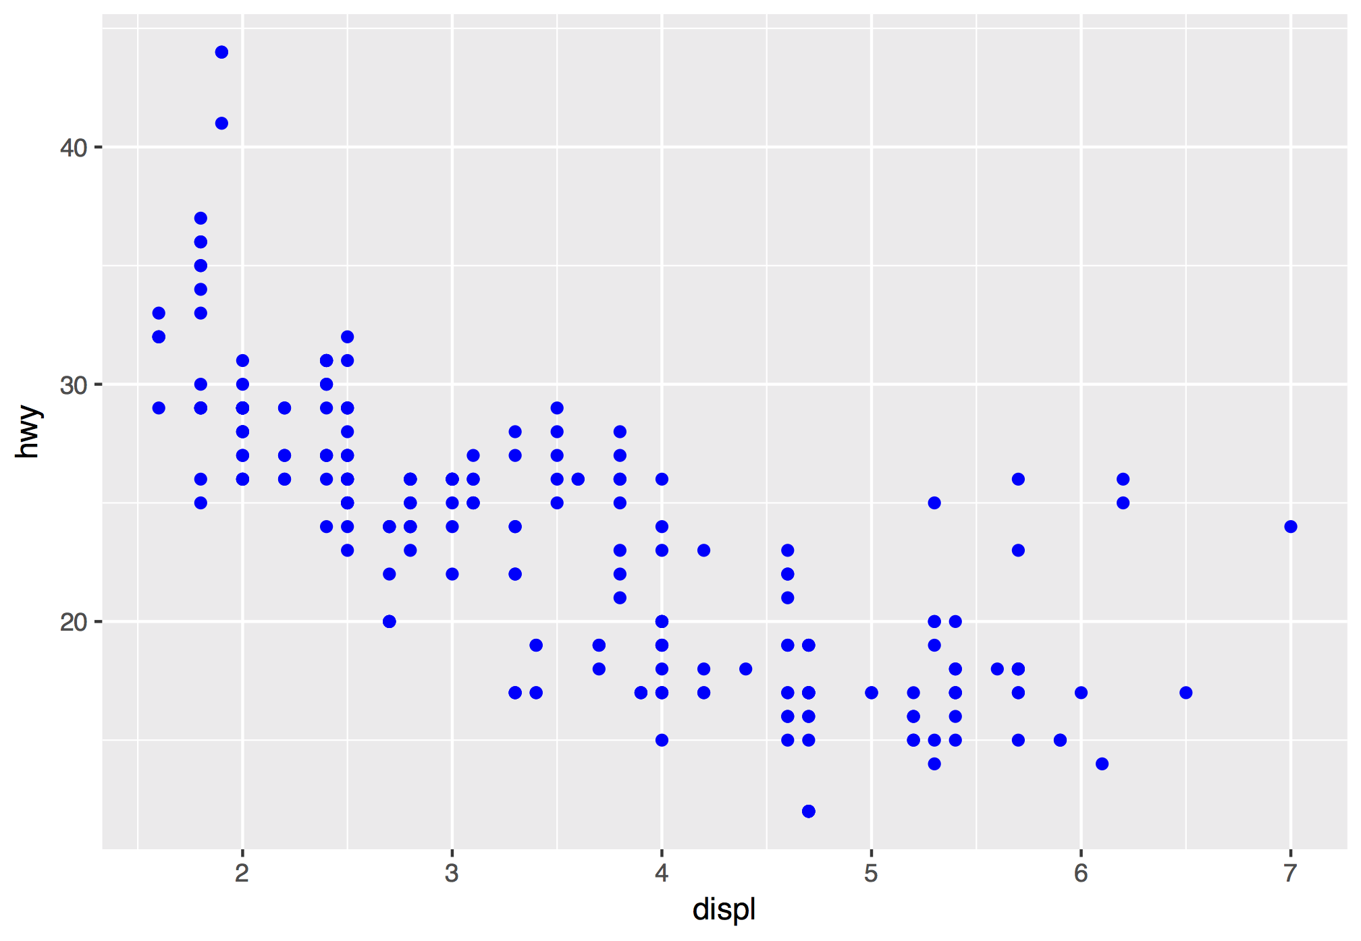
How would you make this plot?
CC BY-SA RStudio

Slide 25
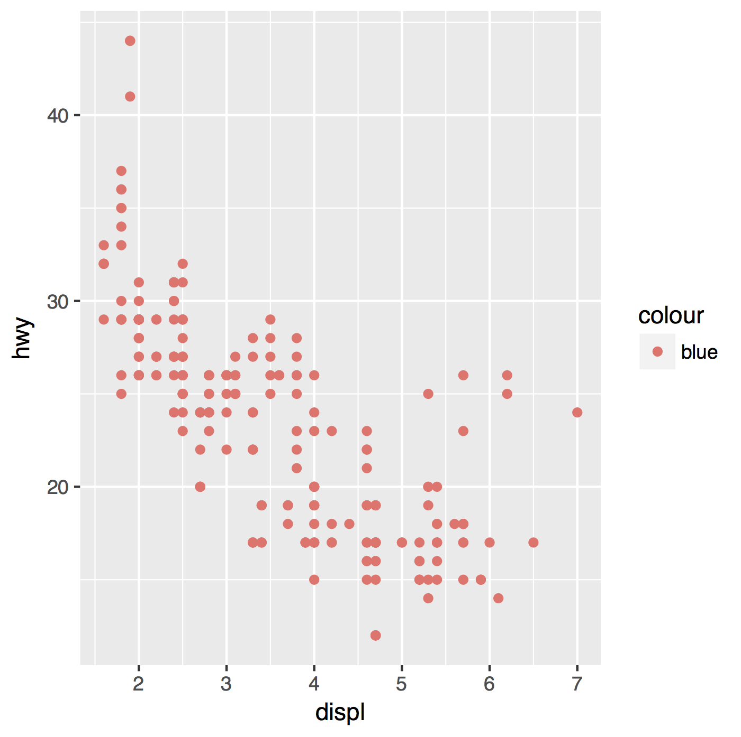
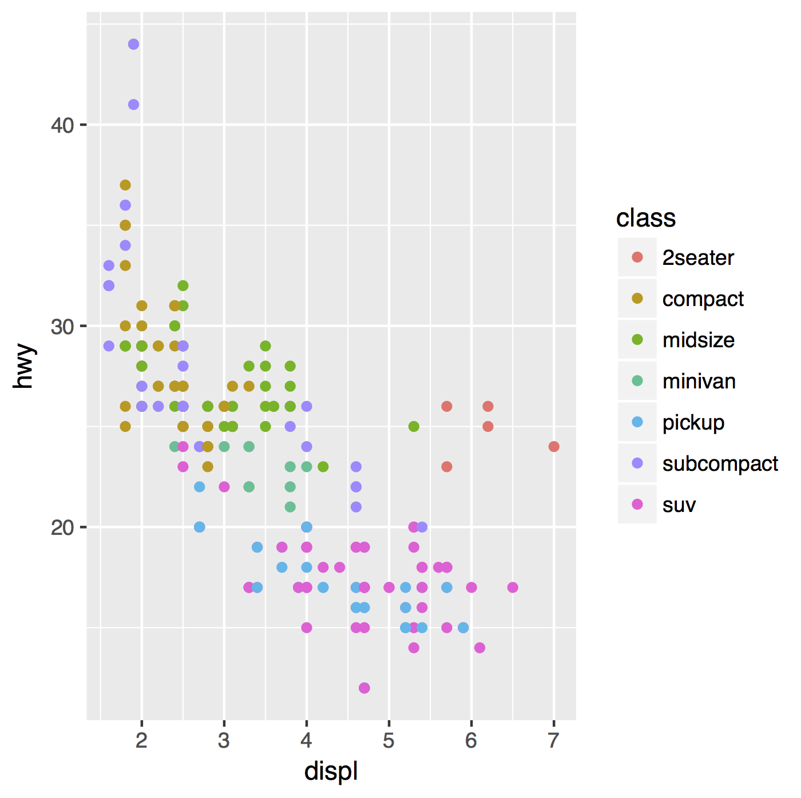
Inside of aes(): maps an aesthetic to a variable
ggplot(mpg) + geom_point(aes(x = displ, y = hwy, color = class))
CC BY-SA RStudio

Slide 26
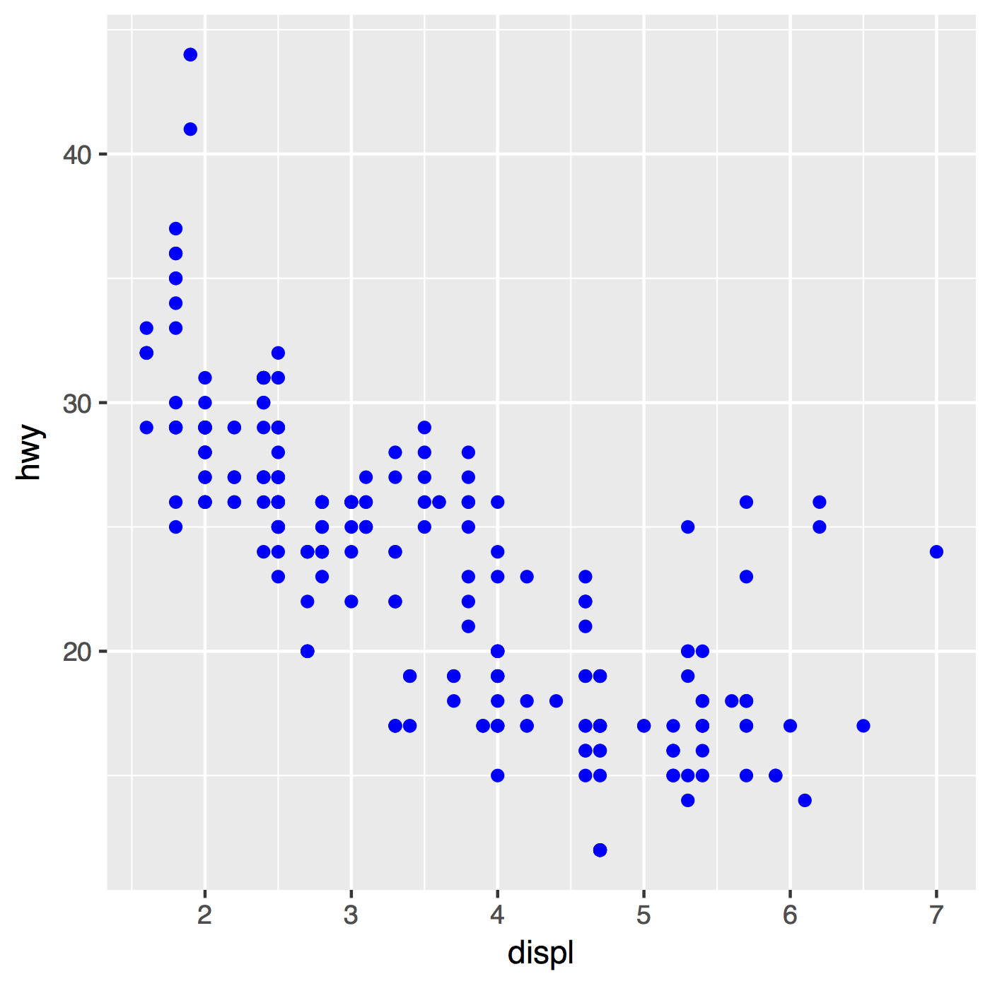
Outside of aes(): sets an aesthetic to a value
ggplot(mpg) + geom_point(aes(x = displ, y = hwy, color = class))
ggplot(mpg) + geom_point(aes(x = displ, y = hwy), color = "blue")
CC BY-SA RStudio

Slide 27
ggplot(mpg) + geom_point(aes(x = displ, y = hwy, color = class))
ggplot(mpg) + geom_point(aes(x = displ, y = hwy), color = "blue")
CC BY-SA RStudio

Slide 28
ggplot(mpg) + geom_point(aes(x = displ, y = hwy, color = "blue"))
ggplot(mpg) + geom_point(aes(x = displ, y = hwy), color = "blue")
CC BY-SA RStudio

Slide 29
Geoms

Slide 30
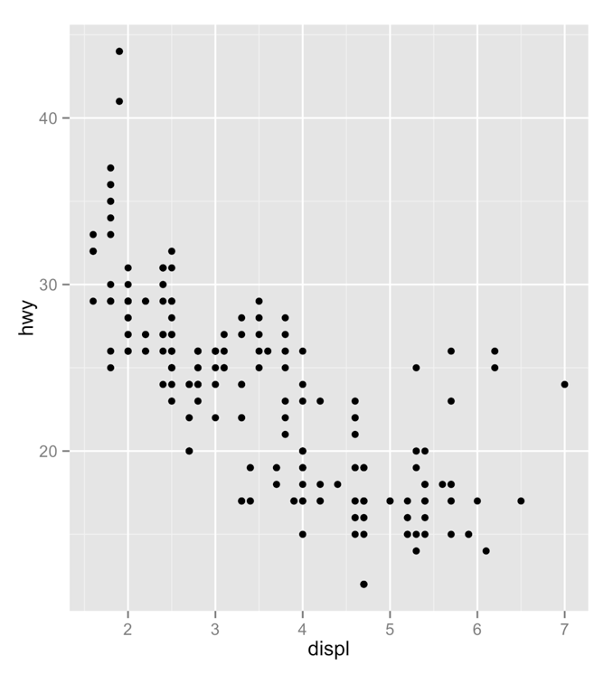
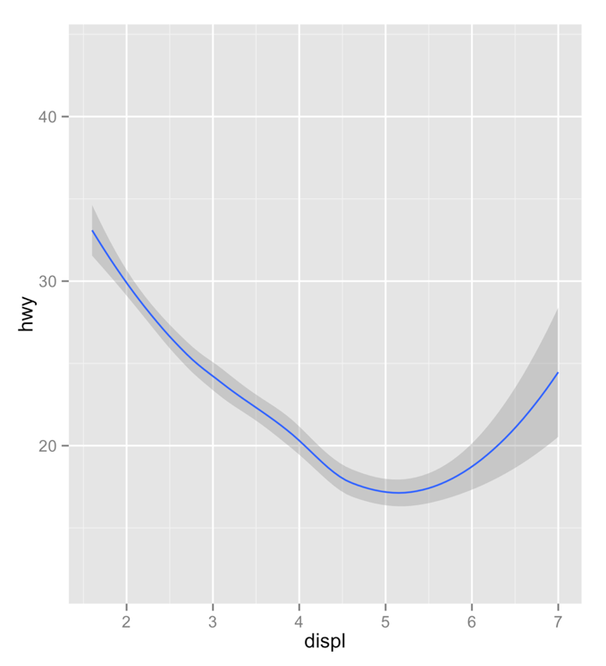
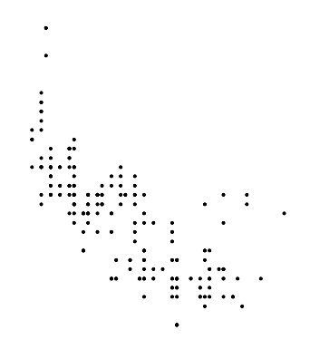
How are these plots similar?
Same:
x var
, y var
, data
CC BY-SA RStudio

Slide 31
How are these plots different?
Different: geometric object (geom),
e.g. the visual object used to represent the data
CC BY-SA RStudio

Slide 32
geoms
ggplot(data = <DATA>) +
<GEOM_FUNCTION>(mapping = aes(<MAPPINGS>))
CC BY-SA RStudio

Slide 33
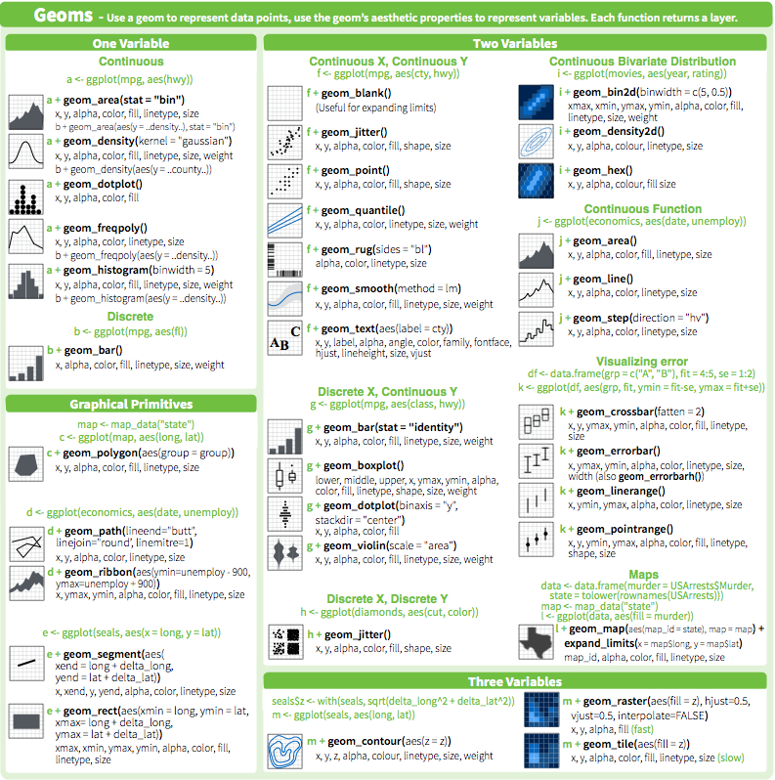
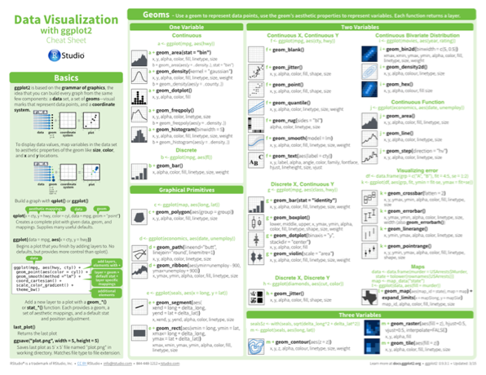
geom_ functions
Each requires a mapping argument.
CC BY-SA RStudio

Slide 34
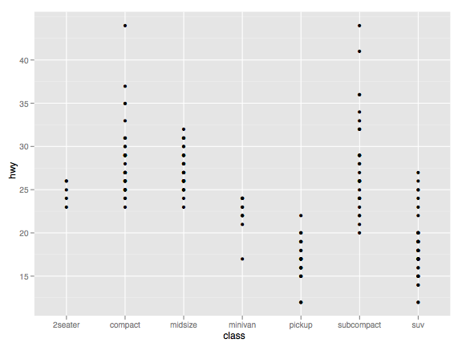
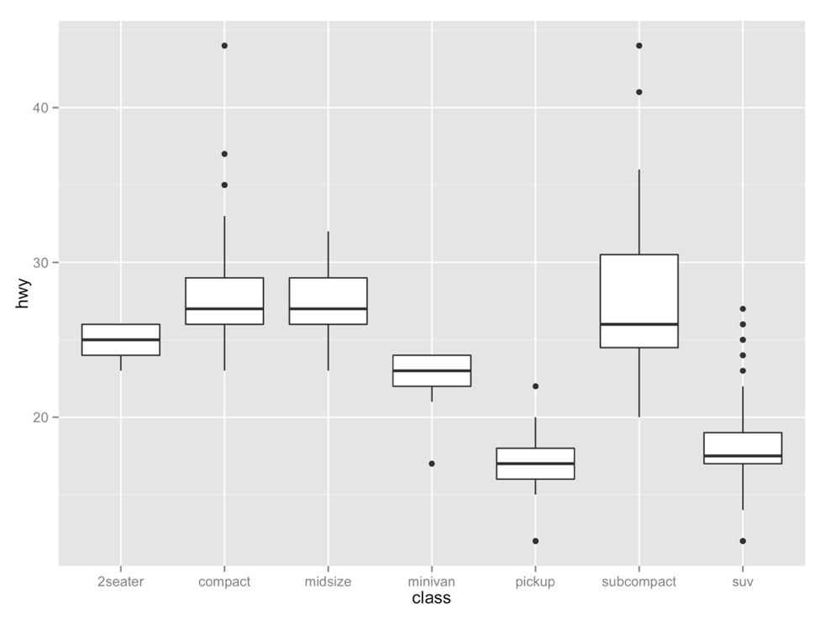
Your Turn 3
Decide how to replace this scatterplot with one that draws boxplots? Use the cheatsheet. Try your best guess.
ggplot(mpg) + geom_point(aes(class, hwy))
2 minutes

Slide 35
ggplot(data = mpg) +
geom_boxplot(mapping = aes(x = class, y = hwy))
CC BY-SA RStudio

Slide 36
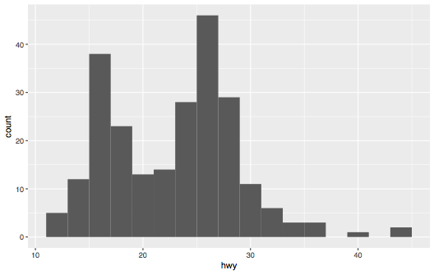
Your Turn 4
Make the histogram of hwy below. Use the cheatsheet. Hint: do not supply a y variable.
2 minutes

Slide 37
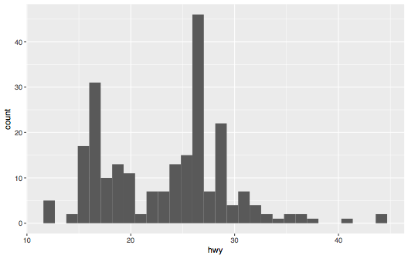
ggplot(data = mpg) +
geom_histogram(mapping = aes(x = hwy))
CC BY-SA RStudio

Slide 38
?
ggplot(data = mpg) +
geom_histogram(mapping = aes(x = hwy), binwidth = 2)
CC BY-SA RStudio

Slide 39
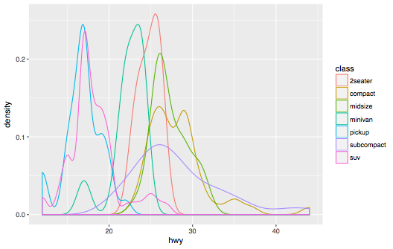
Your Turn 5
Make the density plot of hwy colored by class below. Use the cheatsheet. Try your best guess.
2 minutes

Slide 40
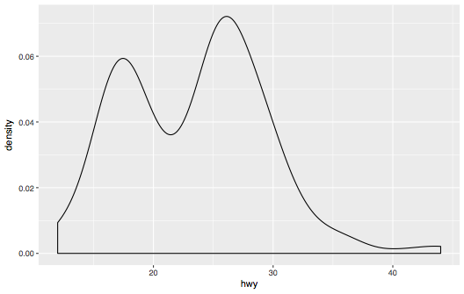
ggplot(data = mpg) +
geom_density(mapping = aes(x = hwy))
CC BY-SA RStudio

Slide 41
ggplot(data = mpg) +
geom_density(mapping = aes(x = hwy, color = class))
CC BY-SA RStudio

Slide 42
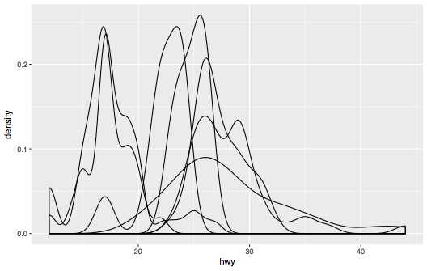
ggplot(data = mpg) +
geom_density(mapping = aes(x = hwy, group = class))
CC BY-SA RStudio

Slide 43
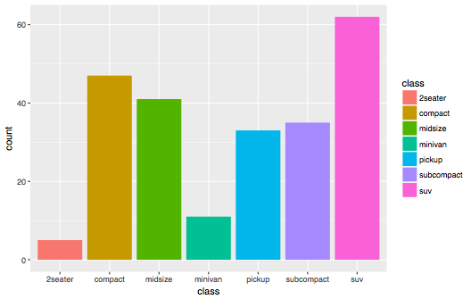
Your Turn 6
Make the bar chart of hwy colored by class below. Use the cheatsheet. Try your best guess.
2 minutes

Slide 44
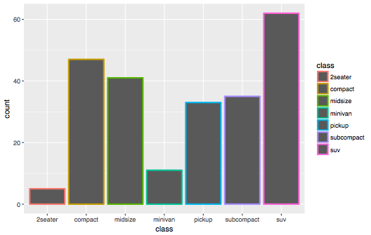
ggplot(data = mpg) +
geom_bar(mapping = aes(x = class, color = class))
CC BY-SA RStudio

Slide 45
ggplot(data = mpg) +
geom_bar(mapping = aes(x = class, fill = class))
CC BY-SA RStudio

Slide 46
Your Turn 7
Take a moment to predict what this code will do.
Then run it.
ggplot(mpg) +
geom_point(aes(displ, hwy)) +
geom_smooth(aes(displ, hwy))
3 minutes

Slide 47
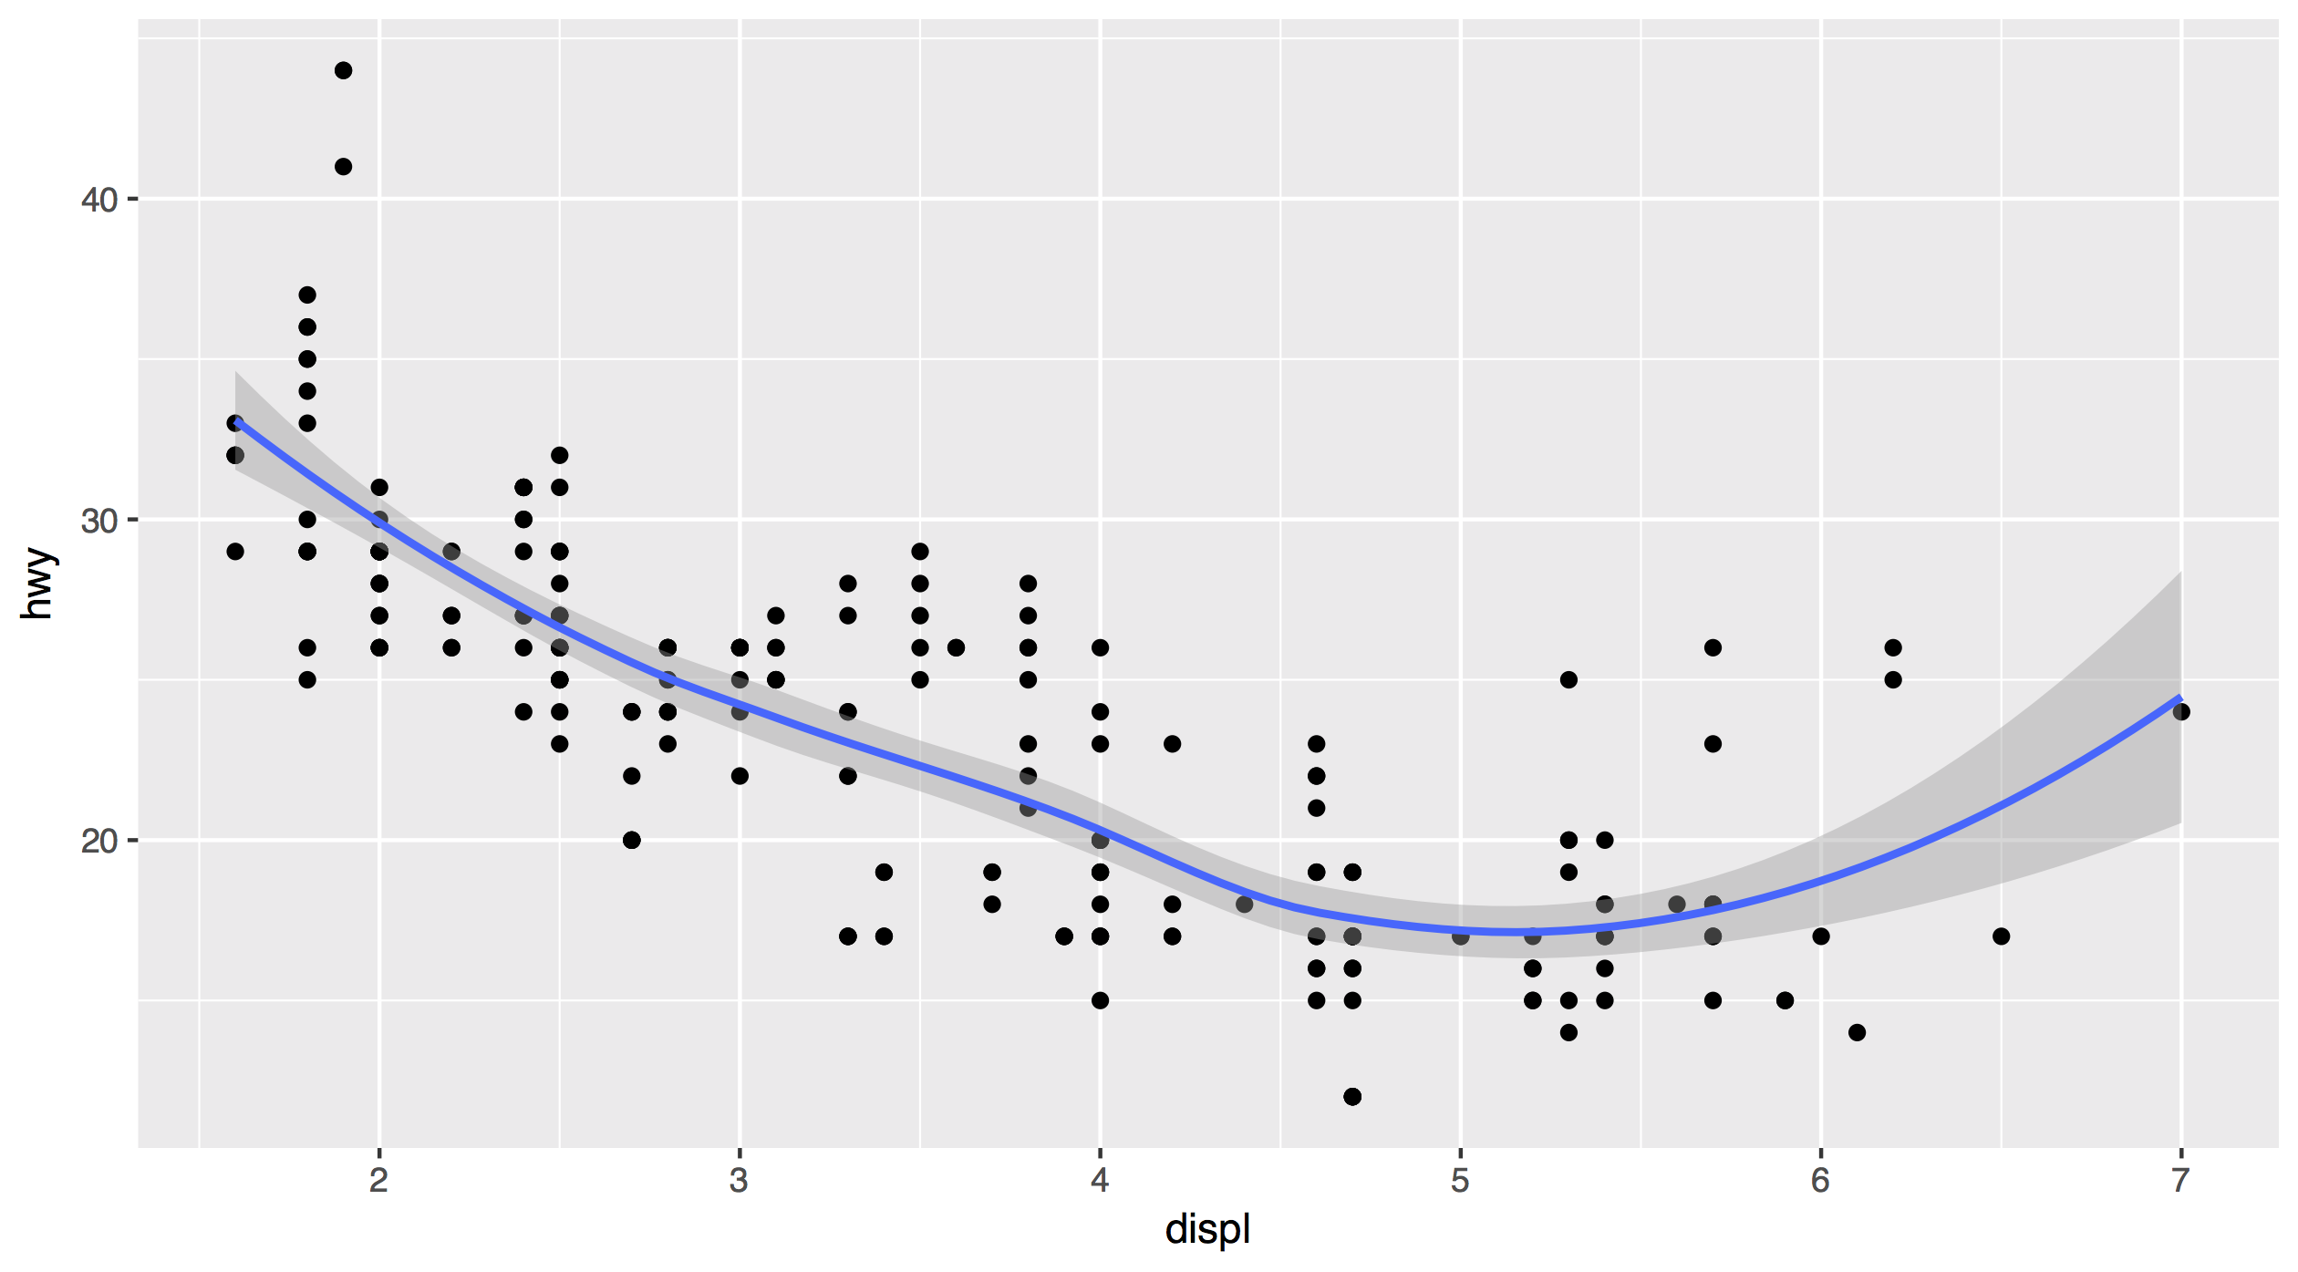
Each new geom adds a new layer
ggplot(data = mpg) +
geom_point(mapping = aes(x = displ, y = hwy)) +
geom_smooth(mapping = aes(x = displ, y = hwy))
CC BY-SA RStudio

Slide 48
Each new geom adds a new layer
ggplot(data = mpg) +
geom_point(mapping = aes(x = displ, y = hwy)) +
geom_smooth(mapping = aes(x = displ, y = hwy))
CC BY-SA RStudio

Slide 49
global vs. local

Slide 50
Mappings (and data) that appear in ggplot() will apply globally to every layer
ggplot(data = mpg, mapping = aes(x = displ, y = hwy)) +
geom_point() +
geom_smooth()
CC BY-SA RStudio

Slide 51
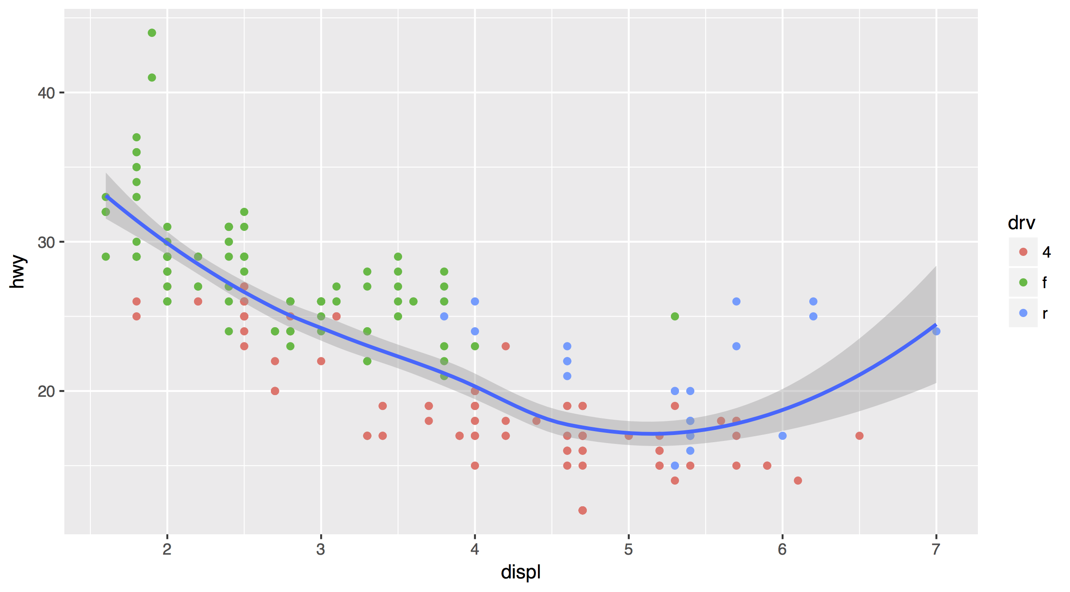
Mappings (and data) that appear in a geom_ function will add to or override the global mappings for that layer only
ggplot(data = mpg, mapping = aes(x = displ, y = hwy)) +
geom_point(mapping = aes(color = drv)) +
geom_smooth()
CC BY-SA RStudio

Slide 52
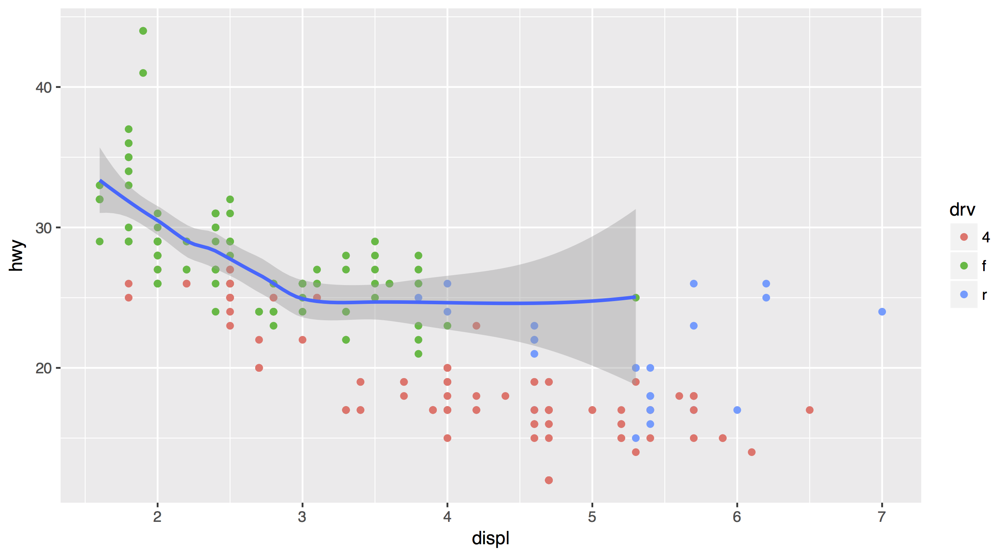
data can also be set locally or globally
ggplot(data = mpg, mapping = aes(x = displ, y = hwy)) +
geom_point(mapping = aes(color = drv)) +
geom_smooth(data = filter(mpg, drv == "f"))
CC BY-SA RStudio

Slide 53
Saving
graphs

Slide 54
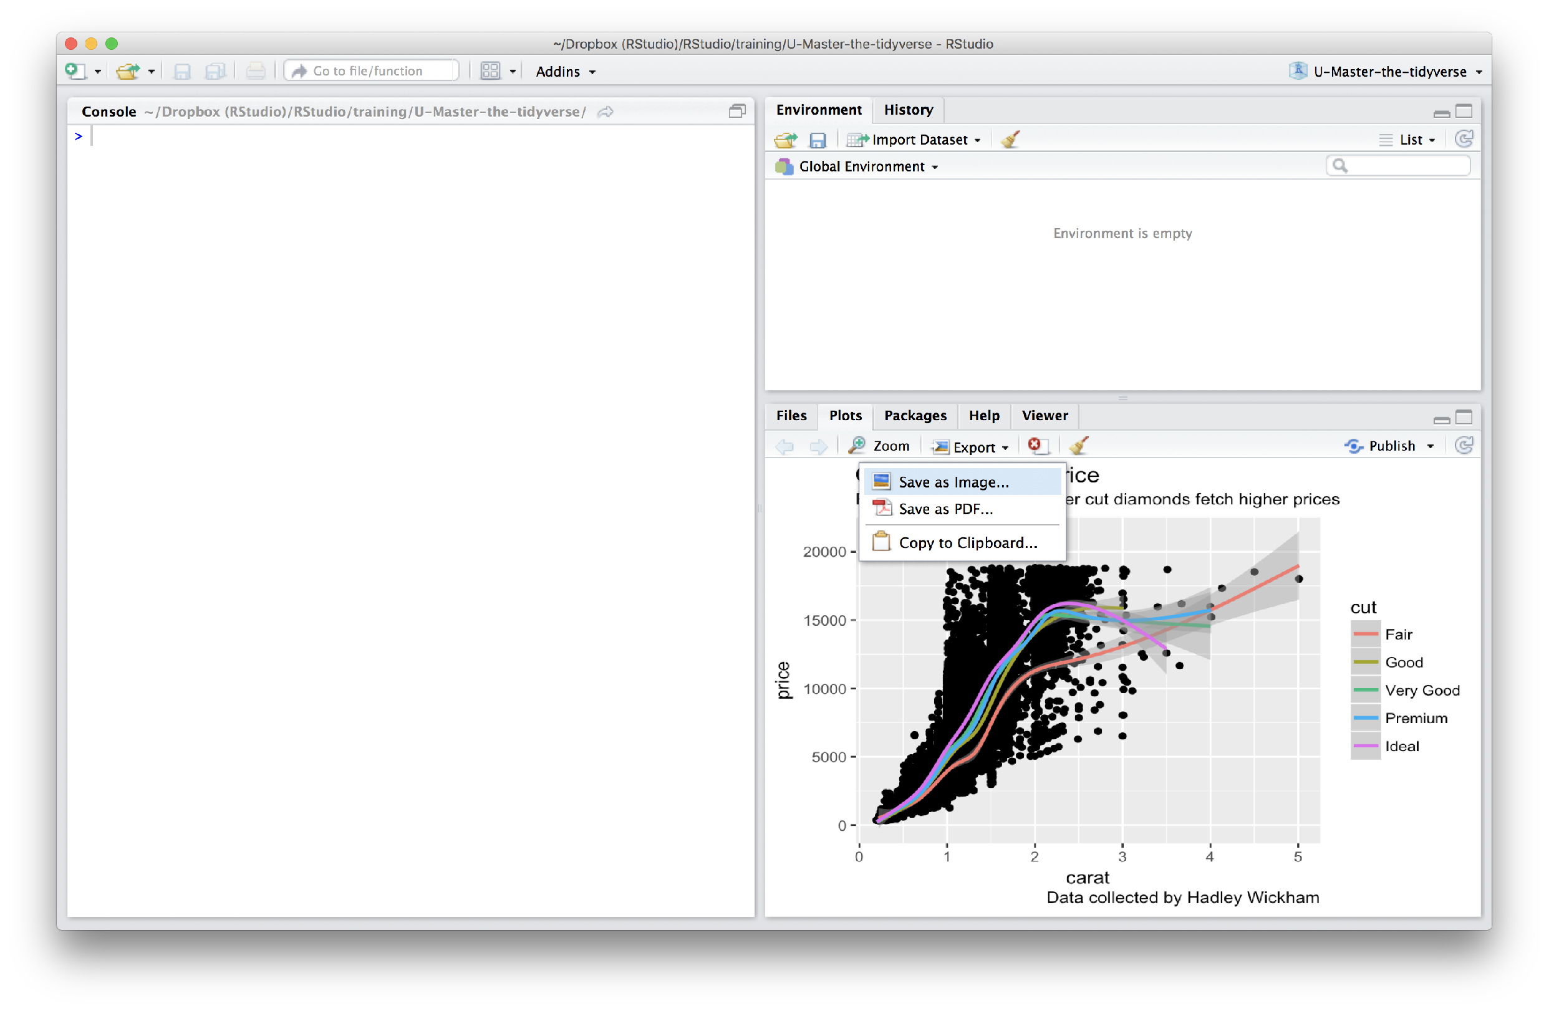
Manually saving plots
Save plots manually with the export menu
CC BY-SA RStudio

Slide 55
Your Turn 8
What does this command return?
getwd()
30 seconds

Slide 56
Working directory
R associates itself with a folder (i.e. directory) on your computer.
This folder is known as your "working directory"
When you save files, R will save them here
When you load files, R will look for them here
CC BY-SA RStudio

Slide 57
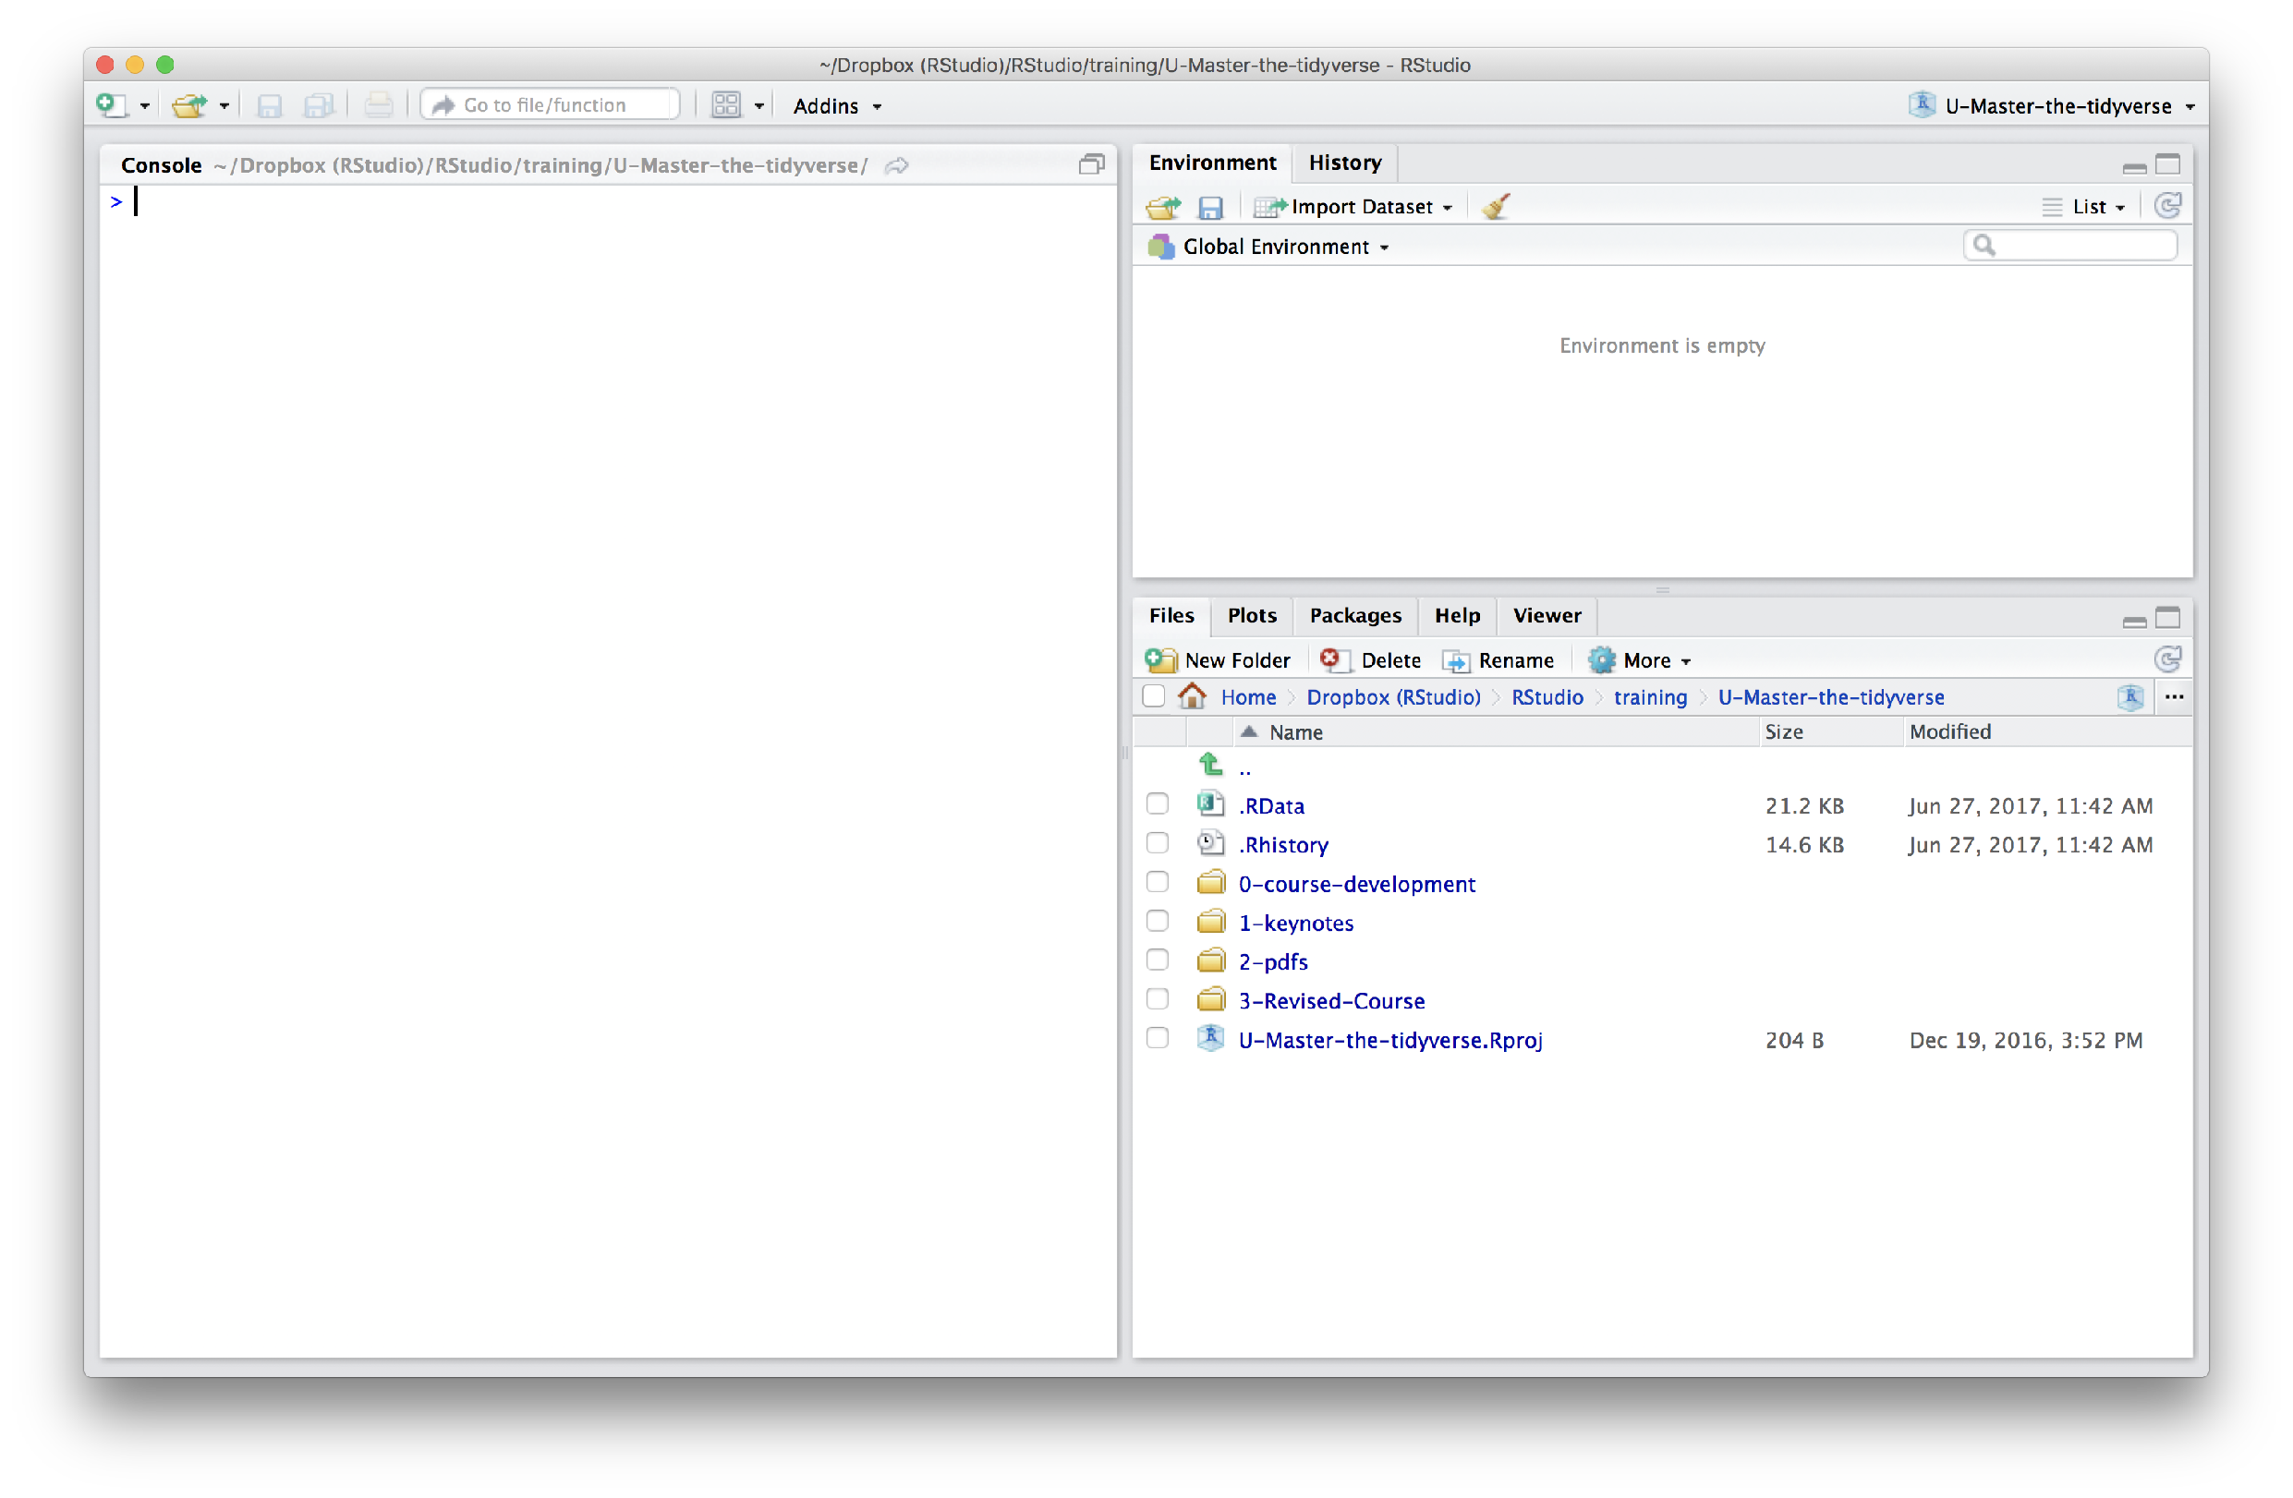
The files pane of the IDE displays the contents of your working directory
CC BY-SA RStudio

Slide 58
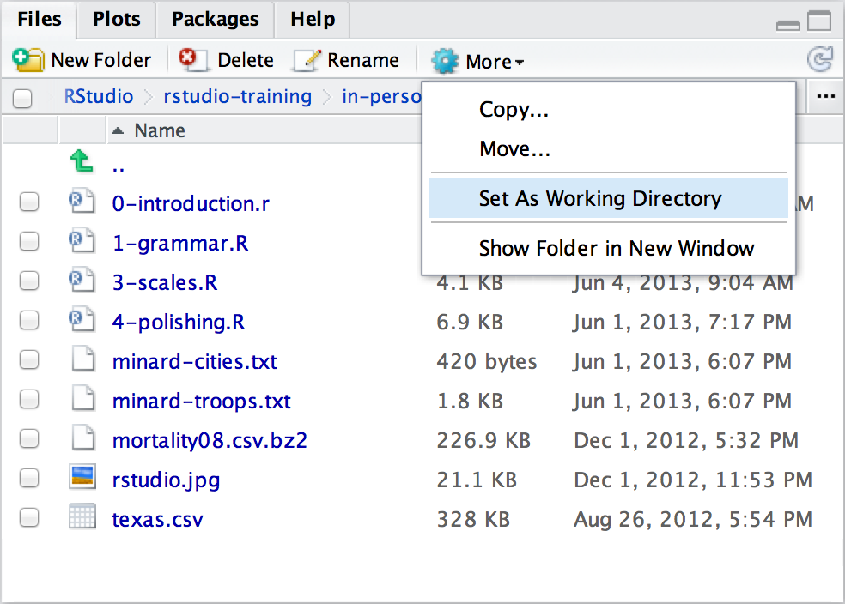
Changing the Working directory
Navigate in the files pane to a new directory. Click
More > Set As Working Directory
CC BY-SA RStudio

Slide 59
Saving plots
ggsave() saves the last plot.
Uses size on screen:
ggsave("my-plot.pdf")
ggsave("my-plot.png")
Specify size in inches
ggsave("my-plot.pdf", width = 6, height = 6)
CC BY-SA RStudio

Slide 60
Saving plots
Assign a plot to an R object:
myPlot1 <- ggplot(data = mpg,
mapping = aes(x = displ, y = hwy)) +
geom_point() +
geom_smooth()
Save that R object to file:
saveRDS(object = myPlot1, file = "myPlot1.Rdata"))
plot1 <- readRDS("myPlot1.Rdata")
CC BY-SA RStudio

Slide 61
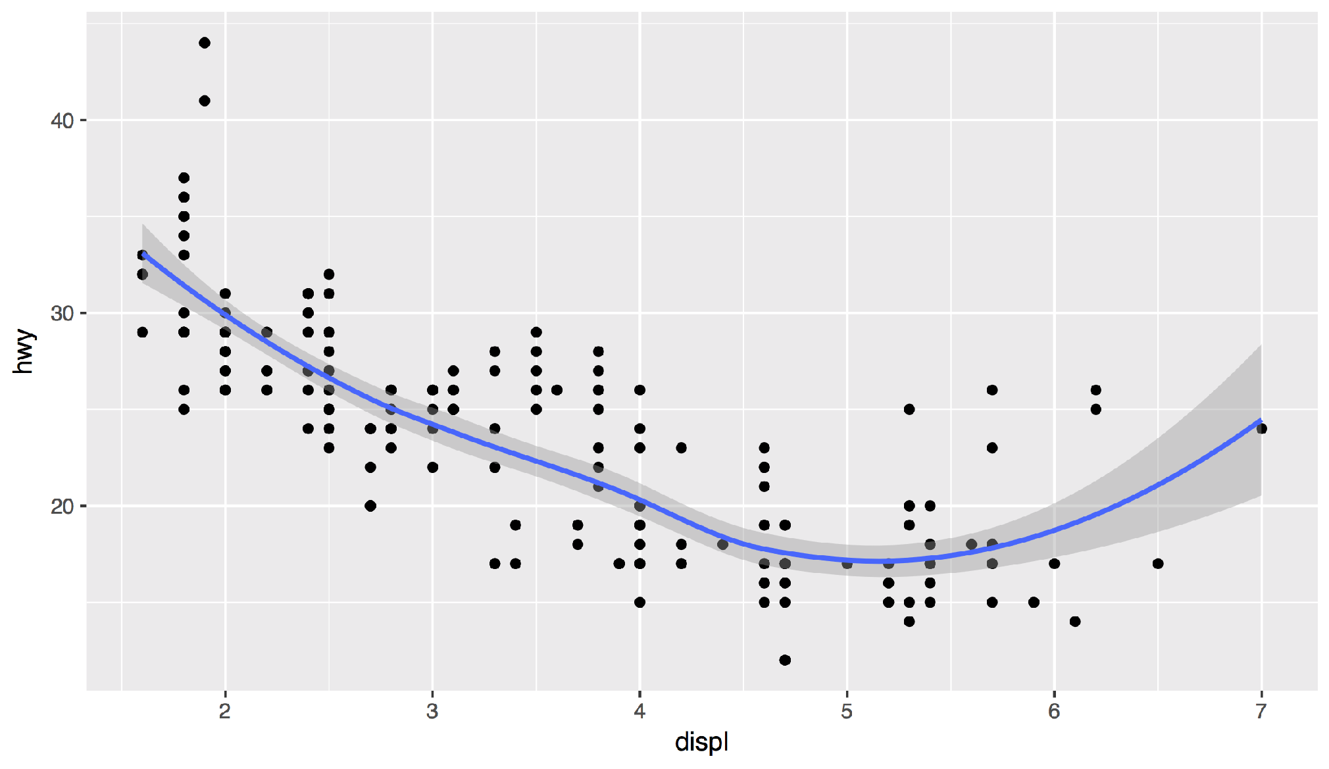
Your Turn 9
Save your last plot and then locate it in your files pane. (You may have to refresh the files list).
1 minute

Slide 62
Grammar
of Graphics

Slide 63
To make a graph
[template]
ggplot(data = <DATA>) +
<GEOM_FUNCTION>(mapping = aes(<MAPPINGS>))
CC BY-SA RStudio

Slide 64
To make a graph
mpg | cyl | disp | hp
21.0 | 6 | 160.0 | 2
21.0 | 6 | 160.0 | 2
22.8 | 4 | 108.0 | 1
21.4 | 6 | 258.0 | 2
18.7 | 8 | 360.0 | 3
18.1 | 6 | 225.0 | 2
14.3 | 8 | 360.0 | 5
24.4 | 4 | 146.7 | 1
22.8 | 4 | 140.8 | 1
19.2 | 6 | 167.6 | 2
17.8 | 6 | 167.6 | 2
16.4 | 8 | 275.8 | 3
17.3 | 8 | 275.8 | 3
15.2 | 8 | 275.8 | 3
10.4 | 8 | 472.0 | 4
10.4 | 8 | 460.0 | 4
14.7 | 8 | 440.0 | 4
32.4 | 4 | 78.7 | 1
30.4 | 4 | 75.7 | 1
33.9 | 4 | 71.1 | 1
Pick a data set
ggplot(data = <DATA>) +
<GEOM_FUNCTION>(mapping = aes(<MAPPINGS>))
data
CC BY-SA RStudio

Slide 65
To make a graph
mpg | cyl | disp | hp
21.0 | 6 | 160.0 | 2
21.0 | 6 | 160.0 | 2
22.8 | 4 | 108.0 | 1
21.4 | 6 | 258.0 | 2
18.7 | 8 | 360.0 | 3
18.1 | 6 | 225.0 | 2
14.3 | 8 | 360.0 | 5
24.4 | 4 | 146.7 | 1
22.8 | 4 | 140.8 | 1
19.2 | 6 | 167.6 | 2
17.8 | 6 | 167.6 | 2
16.4 | 8 | 275.8 | 3
17.3 | 8 | 275.8 | 3
15.2 | 8 | 275.8 | 3
10.4 | 8 | 472.0 | 4
10.4 | 8 | 460.0 | 4
14.7 | 8 | 440.0 | 4
32.4 | 4 | 78.7 | 1
30.4 | 4 | 75.7 | 1
33.9 | 4 | 71.1 | 1
Pick a data set
ggplot(data = <DATA>) +
<GEOM_FUNCTION>(mapping = aes(<MAPPINGS>))
Choose a geom to display cases
data
geom
CC BY-SA RStudio

Slide 66
To make a graph
mappings
fill
mpg | cyl | disp | hp
21.0 | 6 | 160.0 | 2
21.0 | 6 | 160.0 | 2
22.8 | 4 | 108.0 | 1
21.4 | 6 | 258.0 | 2
18.7 | 8 | 360.0 | 3
18.1 | 6 | 225.0 | 2
14.3 | 8 | 360.0 | 5
24.4 | 4 | 146.7 | 1
22.8 | 4 | 140.8 | 1
19.2 | 6 | 167.6 | 2
17.8 | 6 | 167.6 | 2
16.4 | 8 | 275.8 | 3
17.3 | 8 | 275.8 | 3
15.2 | 8 | 275.8 | 3
10.4 | 8 | 472.0 | 4
10.4 | 8 | 460.0 | 4
14.7 | 8 | 440.0 | 4
32.4 | 4 | 78.7 | 1
30.4 | 4 | 75.7 | 1
33.9 | 4 | 71.1 | 1
Pick a data set
ggplot(data = <DATA>) +
<GEOM_FUNCTION>(mapping = aes(<MAPPINGS>))
Map aesthetic properties to variables
Choose a geom to display cases
data
geom
CC BY-SA RStudio

Slide 67
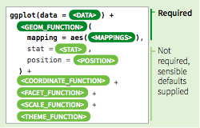
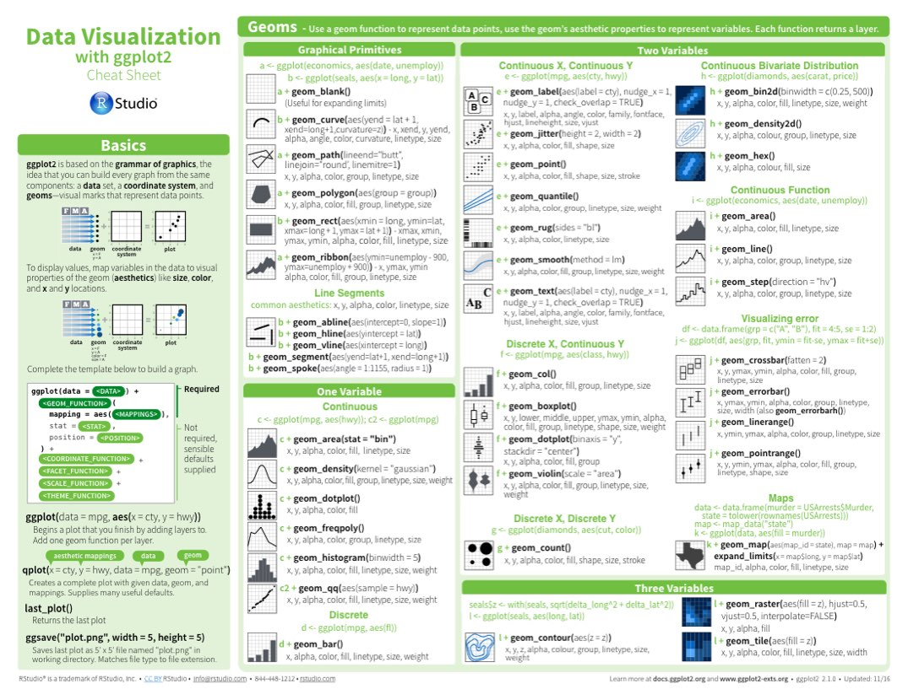
A ggplot2 template
Make any plot by filling in the parameters of this template
CC BY-SA RStudio

Slide 68
Check your understanding

Slide 69
Your Turn
Open /exercises/01-Data-Visualization_PK_concentration.Rmd
Follow the instructions to create a plot of indomethacin concentration profiles over time for the 6 subjects (Spaghetti plots).
Refer to the "Data Visualization with ggplot2" Cheat Sheet and the material from this slidedeck to help fill in the blanks.

Slide 70
What else?

Slide 71
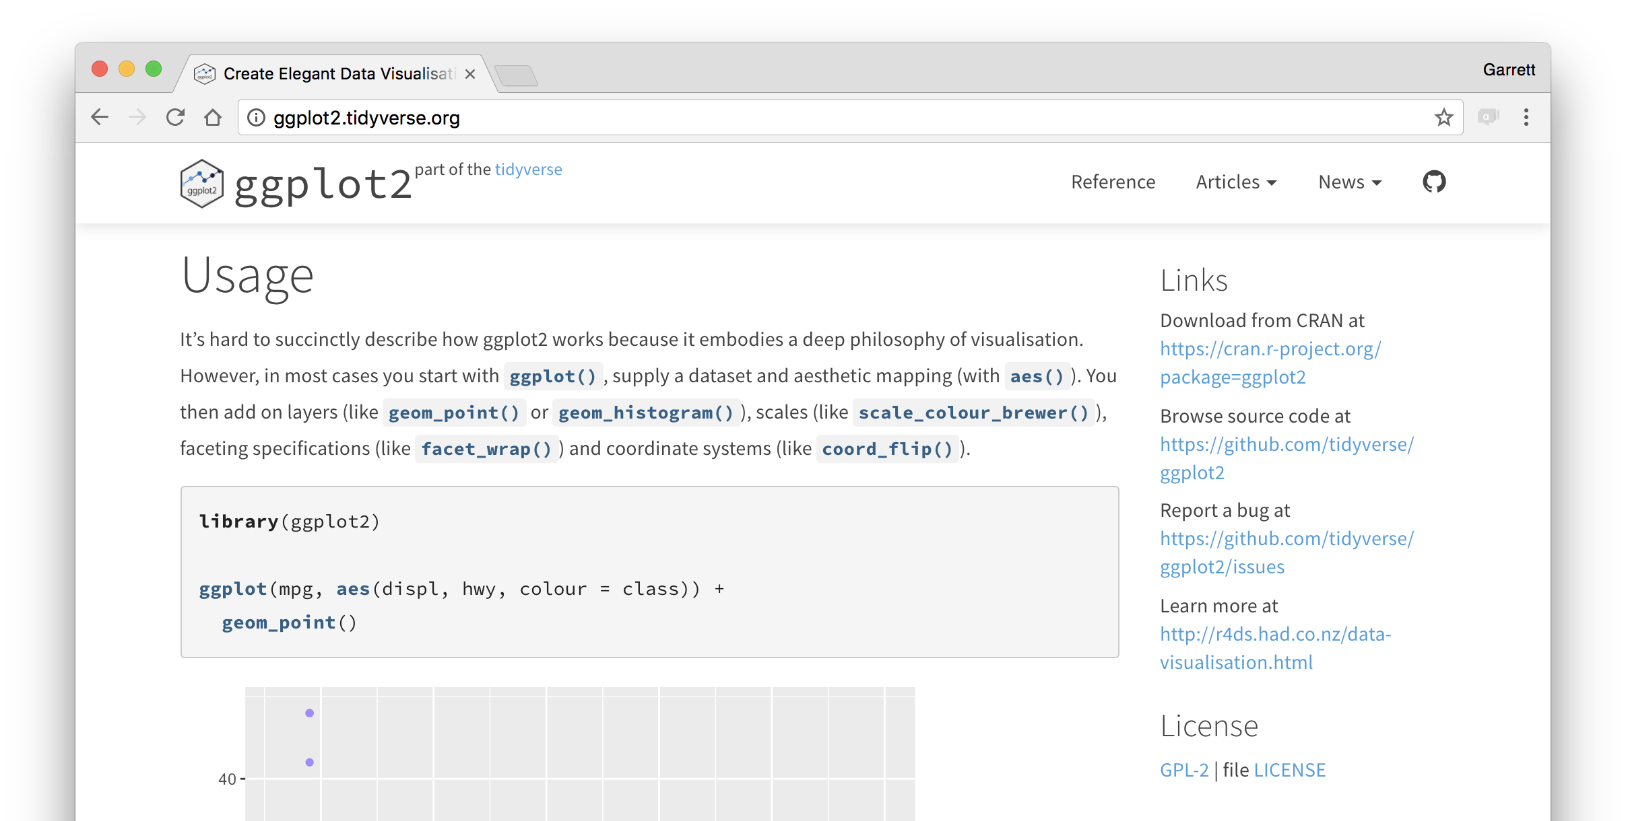
ggplot2.tidyverse.org
CC BY-SA RStudio

Slide 72
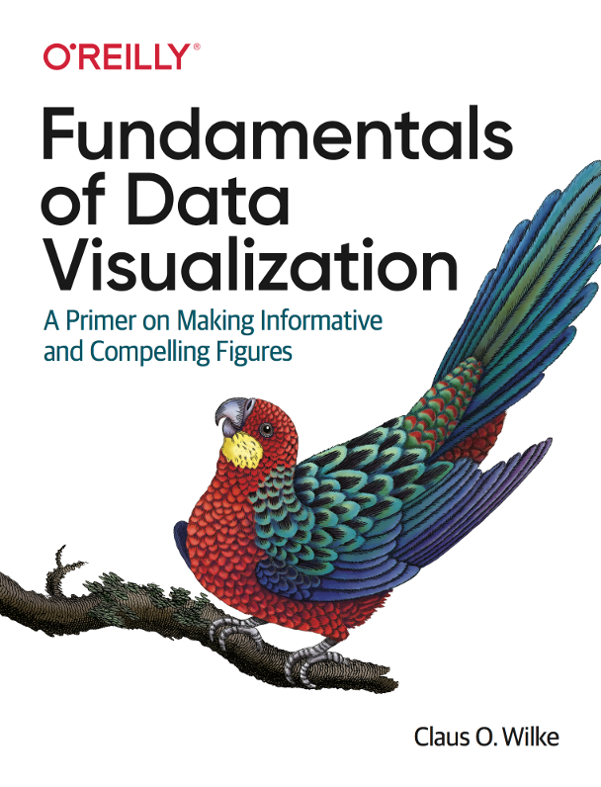
https://serialmentor.com/dataviz/

Slide 73
Your Turn (homework!)
Open /exercises/01_ggplot2_tips_tricks_extensions.Rmd
Run the code chunks to review some additional tips and tricks when working with ggplot2 plot objects.
Consider how to make your graphs more quickly and easily digestible.

Slide 74
For review (homework!)
Visit https://medium.com/bbc-visual-and-data-journalism/how-the-bbc-visual-and-data-journalism-team-works-with-graphics-in-r-ed0b35693535
Read the blog post to see how the BBC use ggplot2 and extensions and themes to bring consistency to their graphics and give their visualizations maximum impact.

